Slide 1
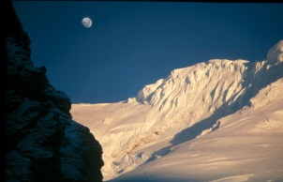
DEFINING AND MEASURING SUSTAINABILITY
XX30191 ENERGY AND ENVIRONMENT 2014
Lecture 3
Peter Harper

Slide 2
AN IMPORTANT DISTINCTION
There is a difference between ‘sustainable’ and ‘environmental’
You can have ‘unsustainable’ national economies, or businesses or health conditions
Many ‘classical’ environmental problems are not ‘unsustainable’ and could continue indefinitely
Horrible buildings, or wind farms
Traffic noise and congestion
Smog, dirty air
Typical levels of water pollution
Litter
Problems of environmental sustainability have boundaries or thresholds, beyond which serious, possibly irreversible, outcomes become more likely, especially in the future
So sustainability inevitably involves processes over time, where benefits and costs might accrue to different people

Slide 3
SUSTAINABILITY ENTAILS AN ELEMENT OF TIME OR ‘FUTURITY’ Often across generations
‘Environmental Sustainability’ was approximated as ‘Sustainable Development’ by Brundtland (1987)
SD defined as ‘development that meets the needs of the present without compromising the needs of the future’
This is a good working definition of environmental sustainability
But trying to quantify the ‘needs of the future’ is problematic
“They” are not here to press their case
The definition needs complementing by consideration of the balance of risks to present and future generations

Slide 4
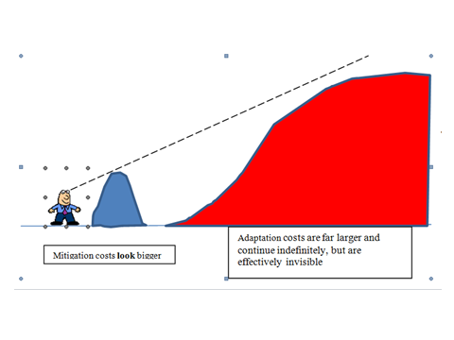
A CARTOON VIEW OF INTERGENERATIONAL EQUITY On most estimates of the relative costs, successful prevention of climate change looks like a bargain from the perspective of people in the future. But from the present perspective, mitigation costs look dauntingly large and adaptation costs virtually invisible.

Slide 5
STANDARD ‘B.A.U.’ MODEL OF MITIGATION PROCESSES With principal actors for each component
Extrapolated trend
(civil sector)
ENVIRONMENTAL IMPACT (NOTIONAL ARITHMETIC SCALE)
Trend identified
(research community/
public sector)
Outcome (private sector)
Mitigation legislation (public sector)

Slide 6
THRESHOLD ADDED TO STANDARD MODEL OF MITIGATION PROCESSES
Threshold
Outcomes qualitatively different and possibly irreversible
Extrapolated trend
ENVIRONMENTAL IMPACT (NOTIONAL ARITHMETIC SCALE)
Trend identified
Mitigation measures insufficient or delayed

Slide 7
CRITICS ASK
Can we really give it a reliable value or probability?
Does this threshold really exist?
These are not certainties, merely possibilities
Is this extrapolation plausible?
ENVIRONMENTAL IMPACT (NOTIONAL ARITHMETIC SCALE)
Even if they occur, would such outcomes really be so serious?
In any case, would it not be cheaper to pay for adaptation?
Is this trend real?
People in the future will be richer than us, and better able afford the extra costs and risks

Slide 8
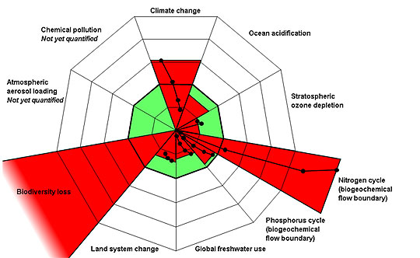
‘PLANETARY BOUNDARIES’ (ROCKSTRÖM et al.,2009) A combination of boundary and trend gives an approximate ranking for urgency
Proposed principal thresholds
Rockström et al., 2009

Slide 9
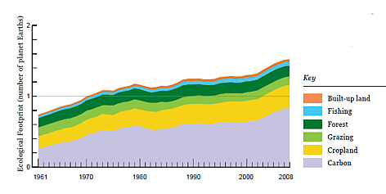
THE ECOLOGICAL FOOTPRINT Source: www.wwf.panda.org
This is also an example of a highly aggregated indicator
Threshold (One Earth)
Categories and proportions correlate well with GHGE

Slide 10
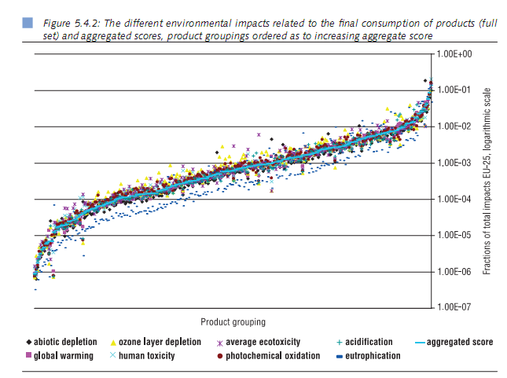
FORTUNATELY DIFFERENT IMPACTS CORRELATE QUITE WELL, MAKING THE PROCESS OF ‘AGGREGATION’ EASIER AND MORE MEANINGFUL Note that ‘global warming’ (GHG emissions) also correlates well with other impacts, suggesting its use as an easily-measured ‘proxy’ in certain circumstances

Slide 11
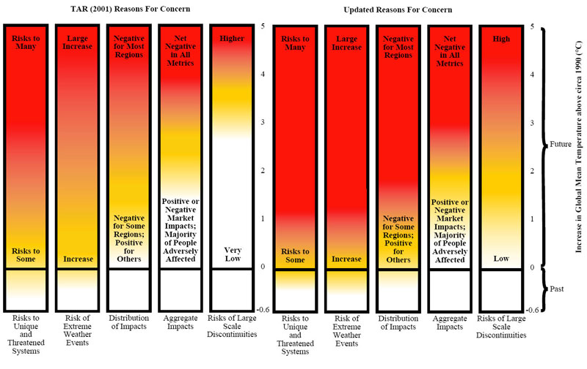
THE CASE OF CLIMATE CHANGE HOW SHOULD WE SET THRESHOLDS? AN UNCOMFORTABLE MIXTURE OF SCIENCE, ETHICS AND POLITICS
http://www.pnas.org/content/106/11/4133.full
“Extremely dangerous”
“Very dangerous”
“Dangerous”

Slide 12
EMISSION OF GHGs (GHGE) IS A GOOD ‘PROXY’ FOR AN AGGREGATED MEASURES OF ENVIRONMENTAL IMPACTS
Aggregating diverse measures is methodologically awkward
GHGE ‘footprint’ methodology is correctly additive
GHGE correlates well with other measures
Possibly a measure of ‘technological brute force’
A good approximation to the ‘Ecological Footprint’
GHGE can be relatively easily and precisely measured at any level, generating single, meaningful values and revealing trends
GHGE can usually be compared against measurable thresholds to indicate urgency and importance
Climate change is a major problem that must be solved, or most other environmental problems become irrelevant

Slide 13
MAIN MEASURES FOR CLIMATE CHANGE
Rate of emissions
Level of GHGs in atmosphere
Actual forcings of temperature
Temperature rise
Probabilities of certain outcomes
Cumulative emissions and ‘Carbon Budgets’

Slide 14
GHG EMISSIONS (GHGE)
Not all CO₂
Kyoto ‘basket’
CO₂, CH₄, N₂O, CFCs, SF₆, others
Some argument about how to add them up
Usually 100-year equivalent to CO₂in terms of Global Warming Potential (GWP)
Unit is CO₂e
Usually expressed as a rate, e.g., MtCO₂e/y
Present world level ~45 GtCO₂e/y
Proposed sustainable level zero by 2050?

Slide 15
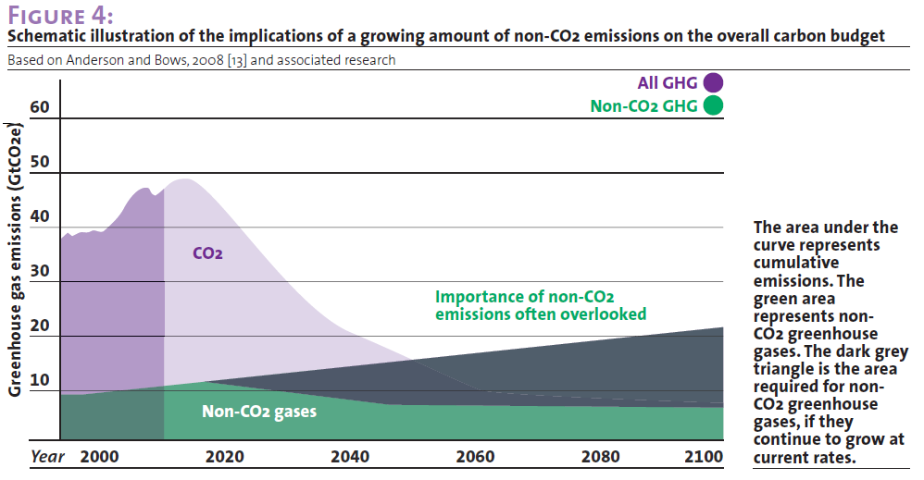
RELATIVE WORLD EMISSIONS OF CO2 AND NON-CO2 GHGS

Slide 16
CONCENTRATION OF GHGs IN ATMOSPHERE
Not all GHGE end up in the atmosphere
Almost half goes into oceans and biomass
But the two are obviously related
Usually measured in ppm of CO₂ or total GHG in equivalents CO₂e
Pre-industrial level 270 ppm, measured now 400 ppmCO₂
Targets proposed: 550, 450, 350 ppm

Slide 17
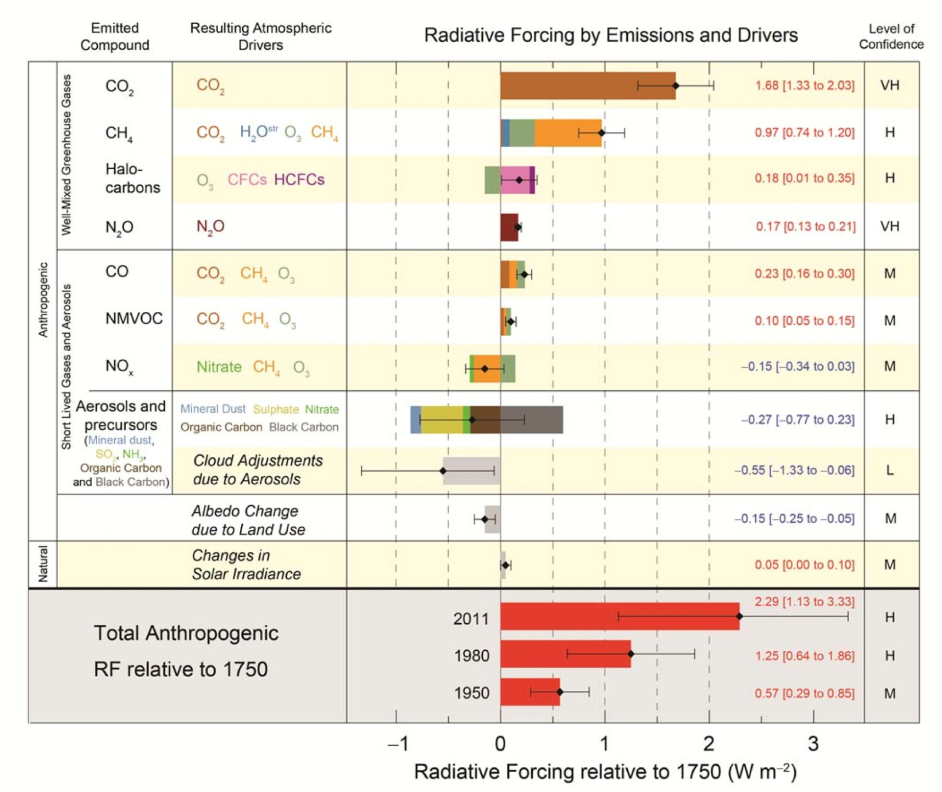
ACTUAL ‘FORCINGS’: NOT ALL DUE TO GHG
Usually measured in Watts per square metre
Ultimate target: net zero
Source: IPCC AR5 (2013)

Slide 18
ATMOSPHERIC TEMPERATURE
Not so very easy to measure
Many different methods and sample points required
‘Sensitivity’ to forcing remains uncertain
Current level around 0.8ºC above baseline
This generates measurable and noticeable effects
Risks of knock-on effects and ‘non-linear responses’ are thought to rise sharply above 2ºC
2ºC is considered the working threshold for ‘dangerous climate change’ that must not be exceeded
Current forcing trends would lead to 3º-4ºC if maintained

Slide 19
PROBABILITIES
Processes and outcomes cannot be exactly determined or predicted
Probabilities are assigned on the basis of modelling and informed estimates
They are subject to review and modification with new data and understandings
Scenarios and policy measures are commonly evaluated in terms of their probability of exceeding the 2ºC threshold
Level of risk-taking is a political or ethical matter, not a scientific one
Likelihood Terminology | Likelihood of the occurrence/ outcome
Virtually certain | > 99% probability
Extremely likely | > 95% probability
Very likely | > 90% probability
Likely | > 66% probability
More likely than not | > 50% probability
About as likely as not | 33 to 66% probability
Unlikely | < 33% probability
Very unlikely | < 10% probability
Extremely unlikely | < 5% probability
Exceptionally unlikely | < 1% probability
Source IPCC AR4, 2007

Slide 20
THE PRINCIPLE OF CUMULATIVE EMISSIONS
Many GHGs remain in the atmosphere for a long time
This is a big difference from most ‘classical’ environmental problems, that are self-correcting once the inputs stop
Reduction targets and dates for GHG reduction are not enough to guarantee reduced concentrations
Total accumulated emissions becomes a key metric
This can be related to a global ‘carbon budget’ to guide policy, that can be expressed in GtCO₂e, approximately equivalent to “450ppm”

Slide 21
The principle of calculating default cumulative emissions tCO₂e/y*y = tCO₂e 637*20/2 = 6370MtCO₂e
Area under the curve
127
127*40+(637-127)*40/2
15296

Slide 22
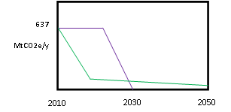
BUT THE TRAJECTORY IS NOT NECESSARILY LINEAR. ITS SHAPE CAN MAKE A LARGE DIFFERENCE TO THE ACCUMULATED EMISSIONS

Slide 23
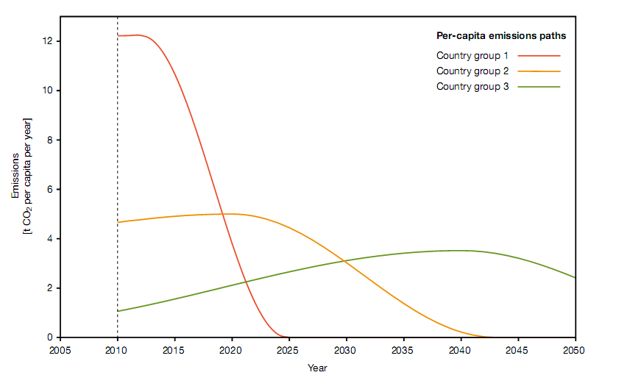
‘CARBON BUDGETS’ OR ALLOWABLE EMISSIONS QUOTAS CAN BE ALLOCATED TO COUNTRIES ON THE BASIS OF EQUAL PER CAPITA ENTITLEMENT
YOU CAN CHOOSE HOW AND WHEN TO ‘SPEND’ YOUR CARBON ALLOWANCE, BUT HIGH EMITTERS HAVE TO MOVE FASTER
GERMAN ADVISORY COUNCIL ON GLOBAL CHANGE

Slide 24
CALCULATING THE UK’S SUSTAINABLE EMISSIONS ENTITLEMENT FROM GLOBAL ESTIMATES OF A ‘BUDGET’ THAT WOULD GIVE 20% CHANCE OF EXCEEDING 2ºC Is this probability unreasonable? Too high? Too low?
AEQ PERIOD | World Quota, GtCO2e | World average population, millions | Per cap quota, tCO2e | Global Per cap per year | UK average population, millions | UK pro rata quota, GtCO2e | UK average quota per year, MtCO2e
1990-2050 | 1722 | 7297 | 236.0 | 3.9 | 68.08 | 16.1 | 268
2000-2050 | 1356 | 7947 | 170.6 | 3.0 | 69.15 | 11.8 | 236
2010-2050 | 894 | 9510 | 107.1 | 2.7 | 70.17 | 7.5 | 188
2015-2050 | 643 | 8729 | 75.4 | 2.2 | 71.19 | 5.4 | 153

Slide 25
THERE REMAINS A PROBLEM OF WHICH UK EMISSIONS TO COUNT
Should we count only the emissions that are generated in the UK itself?
Or should we count all emissions associated with UK consumption, outside the UK?
If we don’t count these in, who does?
Should the allocation period start at some agreed point in the future?
Or should it include some measure of ‘historical responsibility?
If we don’t count these in, who does?

Slide 26
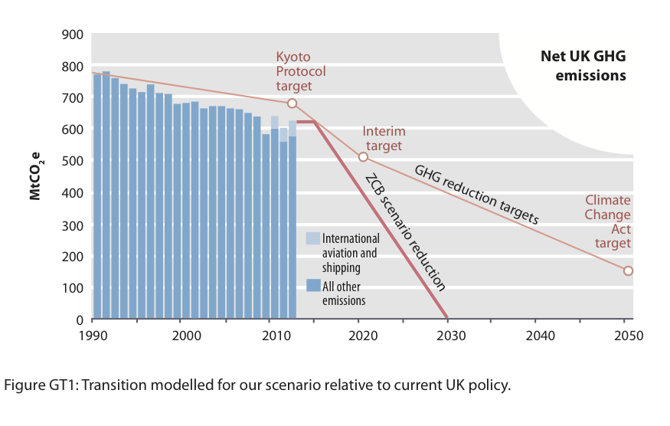
UK official policy, target, results
Notes:
We chose 2030 as a date by which we belive this is technically feasible

Slide 27
Which emissions should we count?
Notes:
We chose 2030 as a date by which we belive this is technically feasible

Slide 28
UK ACCUMULATED EMISSIONS
ALLOWABLE EMISSIONS QUOTA

Slide 30
‘COMPREHENSIVE’ EMISSIONS FRAME FOR THE UK?

Slide 31
UK EMISSIONS ABOVE QUOTA FOR VARIOUS FRAMES Either ‘physics’ or ‘fairness’ must give way, possibly both, making international agreement difficult
 | Excess emissions above equal per-capita quota for 80% chance of remaining under 2ºC, MtCO2e. 2010 UK territorial emissions ~600M/y
AEQ PERIOD | 1. CO2 only | 2. All GHG ‘Territorial account’ | 3. + international transport ‘Production account’ | 4. + emissions embodied in net imports ‘Consumption account’ | 5. +Land use ‘Com-prehensive account’
1990-2050 | 7594 | 12985 | 15890 | 28034 | 32326
2000-2050 | 6201 | 10070 | 12257 | 22773 | 26055
2010-2050 | 5043 | 7883 | 9423 | 16096 | 18369
2015-2050 | 5270 | 7080 | 8595 | 13638 | 15406

Slide 32
THIS IS JUST THE CLIMATE CHANGE ASPECT
The current young generation will also have to deal with land use, the food system, production of goods.
It is helpful to have a physically realistic model of the problems and programmes to engage them
But there is a big gap between physical and political ‘realism’

Slide 33
FURIOUS ACTIVITY
ZCB etc
POLITICAL REALISM
PHYSICAL REALISM
THE YAWNING CHASM

Slide 34
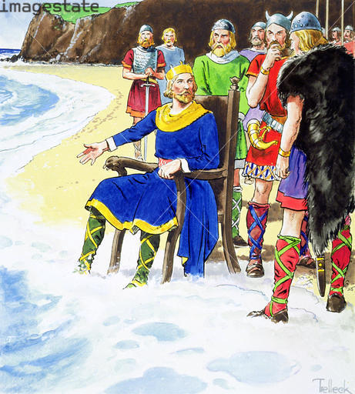
Well guys, it looks as if we have a result
Physics Trumps Politics
Get the physics right, then adjust the politics and economics: NOT the other way round
Credit: © Stapleton Historical Collection / Heritage-Images / Imagestate

Slide 35
CONSIDERATION OF THE WIDE GAP BETWEEN PHYSICAL REQUIREMENTS AND THE LIKELY POLITICAL RESPONSE SUGGESTS A BIFURCATION OF THE HISTORICAL TRAJECTORY
THE ‘POLITICAL’ VIEW
Insistence on maintaining the status quo eventually destroys it
THE ‘PHYSICALIST’ VIEW
Applying necessary adjustments and living with some limitations maintains as much as possible of the status quo
COSTS, RISKS, EFFORT, AND GENERAL UNPLEASANTNESS
TIME, 21ST CENTURY

Slide 36
THE END

