Slide 1
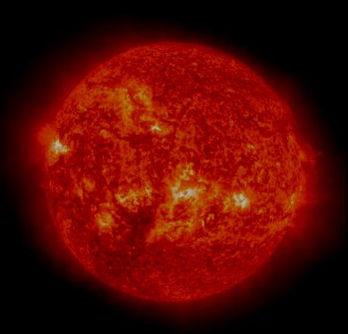
ENERGY:
FAIRNESS,PHYSICS AND SUSTAINABILITY
Peter Harper
University of Bath
Centre for Alternative Technology

Slide 2
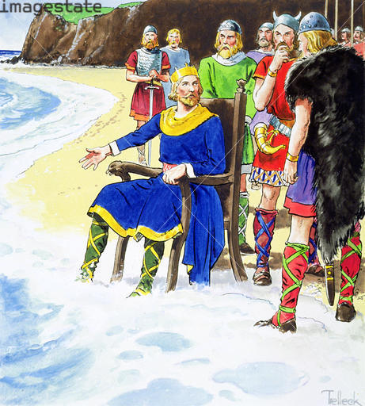
Well guys, it looks as if we have a result
Physics Trumps Politics
Credit: © Stapleton Historical Collection / Heritage-Images / Imagestate

Slide 3

THE CHURCHILL PRINCIPLE

Slide 4
FURIOUS ACTIVITY
ZCB etc
POLITICAL REALISM
PHYSICAL REALISM
THE YAWNING CHASM

Slide 5
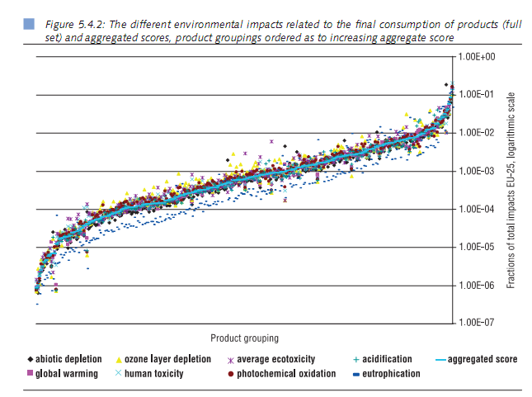
“SUSTAINABILITY” NEEDS QUANTIFYING”
‘GLOBAL WARMING’ ≈ GHG EMISSIONS A GOOD PROXY
MEASURABLE AND CONSERVED

Slide 6
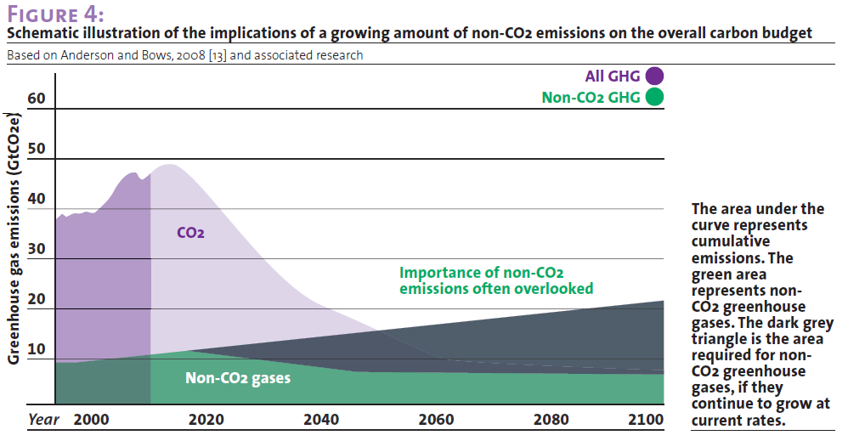
GHG EMISSIONS MOSTLY RELATED TO ENERGY
-- BUT NOT ALL

Slide 7
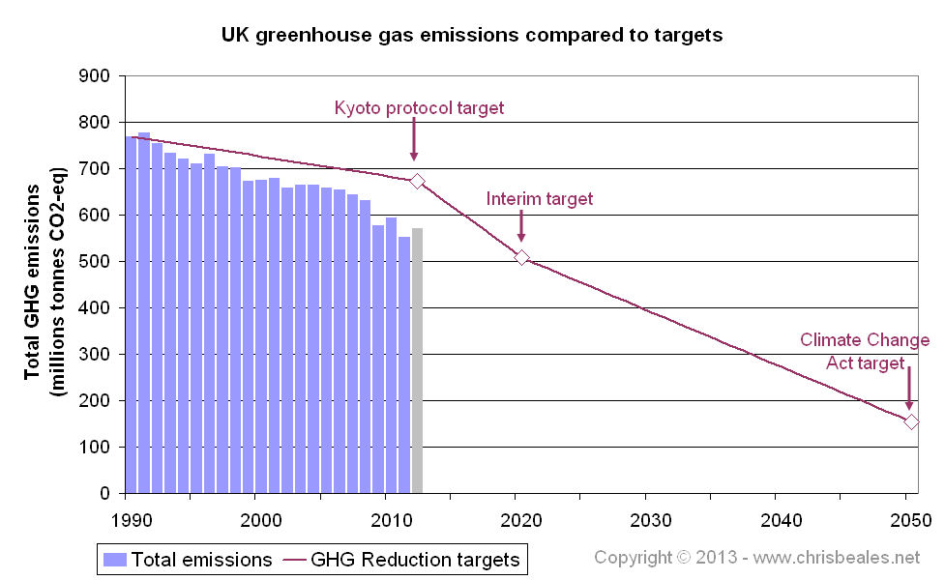

Slide 8
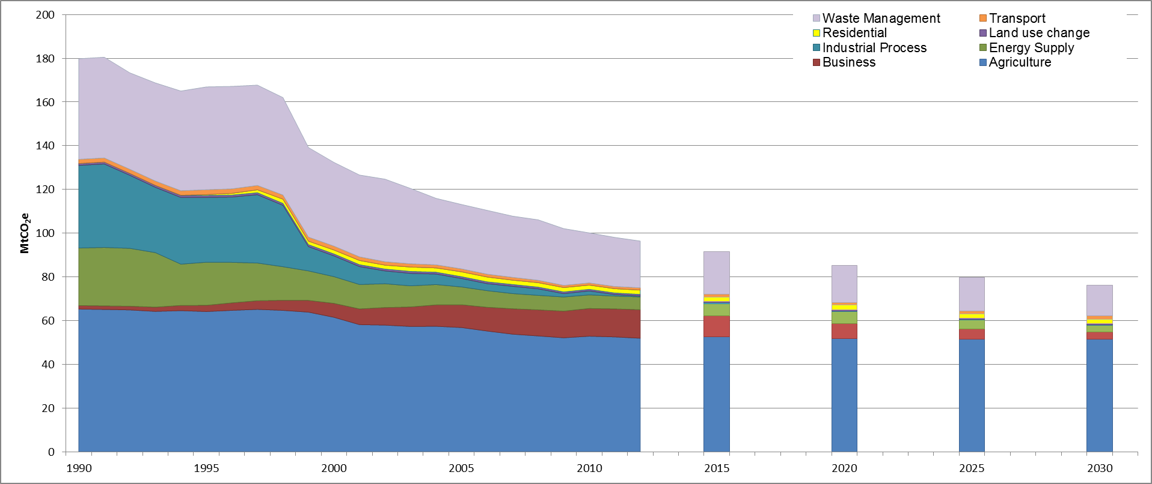
THE UK’S NON-CO2 EMISSIONS

Slide 9
PROJECTIONS OF NON-CO₂ GHGs TO 2050
Methane GWP now considered 36% higher than previously (IPCC)
22% population growth needs proportionately more agricultural production
UK economy expected to grow at 2.1%/yr: double present by 2050.
Waste & demand for non-energy services unlikely to be unaffected

Slide 10
YOU WOULD HAVE TO GET YOUR ENERGY OUT OF THIS BIT
NON-ENERGY EMISSIONS

Slide 11
PROBING 2050 ENERGY EMISSIONS
 | Population p | GDP/cap g | Energy Intensity e | Carbon Intensity f | Total p*g*e*f (Target <50)
 | N x 10^6 | £/N X 10^3 | kWh/£ | kgCO2e/kWh | MtCO2e

Slide 12
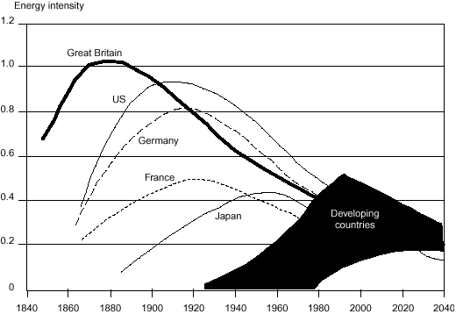
TYPICAL PATTERN OF ENERGY INTENSITY OVER TIME
ENERGY/UNIT GDP

Slide 13
PROBING 2050 ENERGY EMISSIONS
 | Population p | GDP/cap g | Energy Intensity e | Carbon Intensity f | Total p*g*e*f (Target <50)
 | N x 10^6 | £/N X 10^3 | kWh/£ | kgCO2e/kWh | MtCO2e

Slide 14
CARBON INTENSITIES OF ENERGY SYSTEMS
Data from IPCC, 2013
ELECTRICITY
HEAT
TRANSPORT

Slide 15
PROBING 2050 ENERGY EMISSIONS
 | Population | GDP/cap | Energy Intensity | Carbon Intensity | Total (Target <50)
2010 | N x 10^6 | £/n X 10^3 | kWh/£ | kgCO2e/kWh | MtCO2e
Base case | 62 | 23 | 1.28 | 0.27 | 493

Slide 16
PROBING 2050 ENERGY EMISSIONS
 | Population | GDP/cap | Energy Intensity | Carbon Intensity | Total (Target <50)
2010 | N x 10^6 | £/n X 10^3 | kWh/£ | kgCO2e/kWh | MtCO2e
Base case | 62 | 23 | 1.28 | 0.27 | 493
2050
‘BAU’ at 2.1% | 77 | 44.7 | 0.93 | 0.20 | 641

Slide 17
PROBING 2050 ENERGY EMISSIONS
 | Population | GDP/cap | Energy Intensity | Carbon Intensity | Total (Target <50)
2010 | N x 10^6 | £/n X 10^3 | kWh/£ | kgCO2e/kWh | MtCO2e
Base case | 62 | 23 | 1.28 | 0.27 | 493
2050
‘BAU’ | 77 | 44.7 | 0.93 | 0.20 | 641
1% growth | 77 | 29 | 0.93 | 0.20 | 415

Slide 18
PROBING 2050 ENERGY EMISSIONS
 | Population | GDP/cap | Energy Intensity | Carbon Intensity | Total (Target <50)
2010 | N x 10^6 | £/n X 10^3 | kWh/£ | kgCO2e/kWh | MtCO2e
Base case | 62 | 23 | 1.28 | 0.27 | 493
2050
‘BAU’ | 77 | 44.7 | 0.93 | 0.20 | 641
1% growth | 77 | 29 | 0.93 | 0.20 | 415
E Intensity only | 77 | 29 | 0.115 | 0.20 | 50

Slide 19
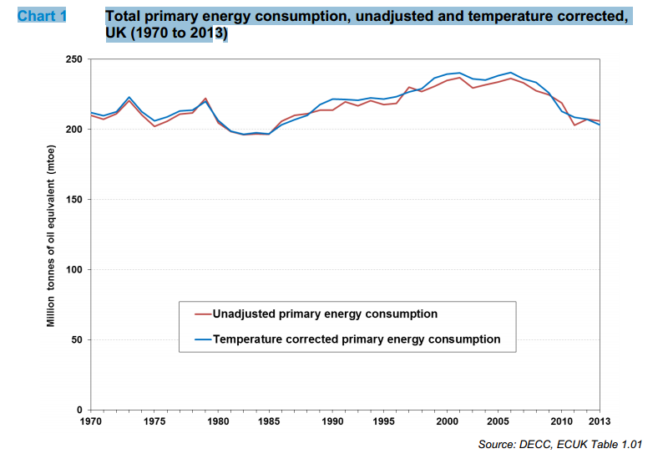
HOW MUCH ENERGY WILL WE USE IN 2050?
EXTRAPOLATE THE LAST 40 YEARS INTO THE NEXT 40?
We are running at about 4kW a head.
Can we imagine running at about 0.5kW?

Slide 20
PROBING 2050 ENERGY EMISSIONS
 | Population | GDP/cap | Energy Intensity | Carbon Intensity | Total (Target <50)
2010 | N x 10^6 | £/n X 10^3 | kWh/£ | kgCO2e/kWh | MtCO2e
Base case | 62 | 23 | 1.28 | 0.27 | 493
2050
‘BAU’ | 77 | 44.7 | 0.93 | 0.20 | 641
1% growth | 77 | 29 | 0.93 | 0.20 | 415
E Intensity only | 77 | 29 | 0.0115 | 0.20 | 50
C intensity only | 77 | 29 | 0.93 | 0.024 | 50

Slide 21
CARBON INTENSITIES OF ENERGY SYSTEMS
Data from IPCC, 2013
ELECTRICITY
HEAT
TRANSPORT

Slide 22
PROBING 2050 ENERGY EMISSIONS
 | Population | GDP/cap | Energy Intensity | Carbon Intensity | Total (Target <50)
2010 | N x 10^6 | £/n X 10^3 | kWh/£ | kgCO2e/kWh | MtCO2e
Base case | 62 | 23 | 1.28 | 0.27 | 493
2050
‘BAU’ | 77 | 44.7 | 0.93 | 0.20 | 641
1% growth | 77 | 29 | 0.93 | 0.20 | 415
E Intensity only | 77 | 29 | 0.0115 | 0.20 | 50
C intensity only | 77 | 29 | 0.93 | 0.024 | 50
E at 60% present | 77 | 29 | 0.760 | 0.029 | 50

Slide 23
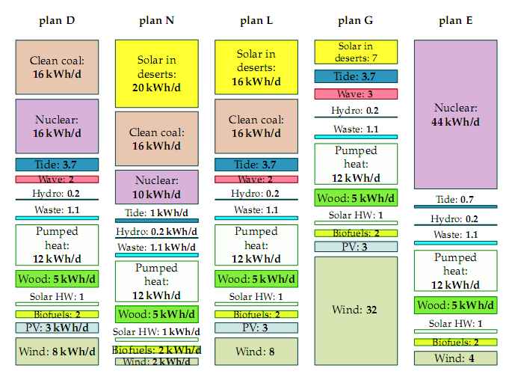
DAVID MACKAY’S
LOW-CARBON SCENARIOS
Proposed by David Mackay, Sustainable Energy Without The Hot Air, 2008

Slide 25
DAVID MACKAY’S SCENARIOS G AND E
Can they work in 2050?

Slide 26
THE BRUTAL PHYSICS
Tells us that, with the exception of limited biomass CCS co-firing, UK commitments cannot be met with more than a very small fraction of fossil fuels, even with widespread CCS
The choices are (mix ‘n match) between
  Energy intensity
  Nuclear
  Renewables
It’s very electric
  More grid, more pylons

Slide 27
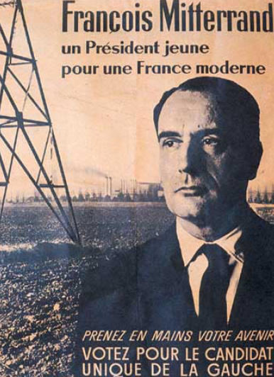

Slide 28
UNFORTUNATELY, UNLIKE MOST OTHER POLLUTANTS, GHGs DON’T GO AWAY QUICKLY
It’s not targets that count: it’s cumulative emissions

Slide 29
WHAT IS THE SUSTAINABLE LEVEL? AND WHAT IS A FAIR QUOTA FOR EACH PERSON OR NATION?
Less than 20% chance of exceeding 2°C
  Is this reasonable?
Allowable emissions 2015-2050 for this level of risk, about 643 GtCO2e
Allocate on an equal per capita basis?
Say average of 8.5 billion people in this period, 76 tCO2 each, 2.2 t per person year
This allocation falls after each year if it is exceeded, but gives us a rough benchmark

Slide 30
WHAT IS BRITAIN’S SHARE OF THE GLOBAL BUDGET?
AEQ PERIOD | World Quota, GtCO2e | World average population, millions | Per cap quota, tCO2e | Global Per cap per year | UK average population, millions | UK pro rata quota, GtCO2e | UK national quota per year, MtCO2e
1990-2050 | 1722 | 7297 | 236.0 | 3.9 | 68.08 | 16.1 | 268
2000-2050 | 1356 | 7947 | 170.6 | 3.0 | 69.15 | 11.8 | 236
2010-2050 | 894 | 8510 | 107.1 | 2.7 | 70.17 | 7.5 | 188
2015-2050 | 643 | 8729 | 75.4 | 2.2 | 71.19 | 5.4 | 153

Slide 31
APPLYING THE BENCHMARK TO THE UK
Less than 2 tCO2e/head

Slide 32
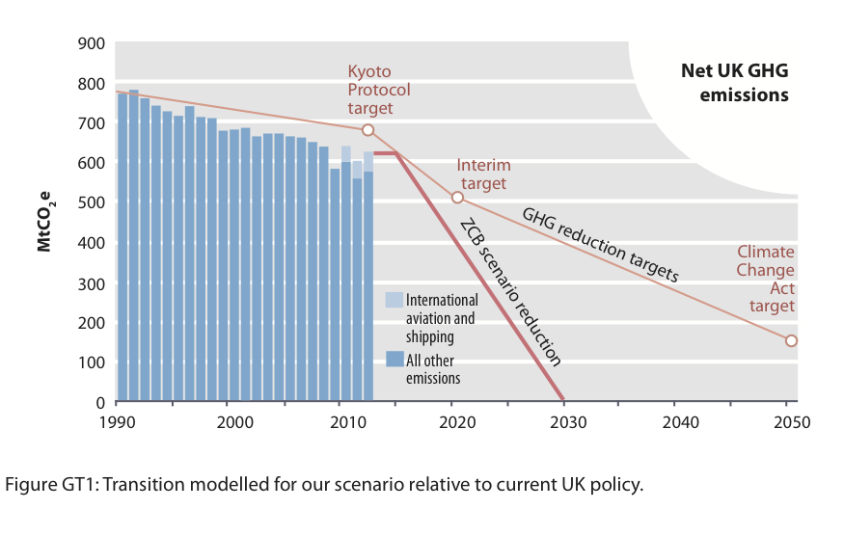
WOULD BOLDER, FASTER TARGETS HELP?
Yes, a bit.

Slide 33
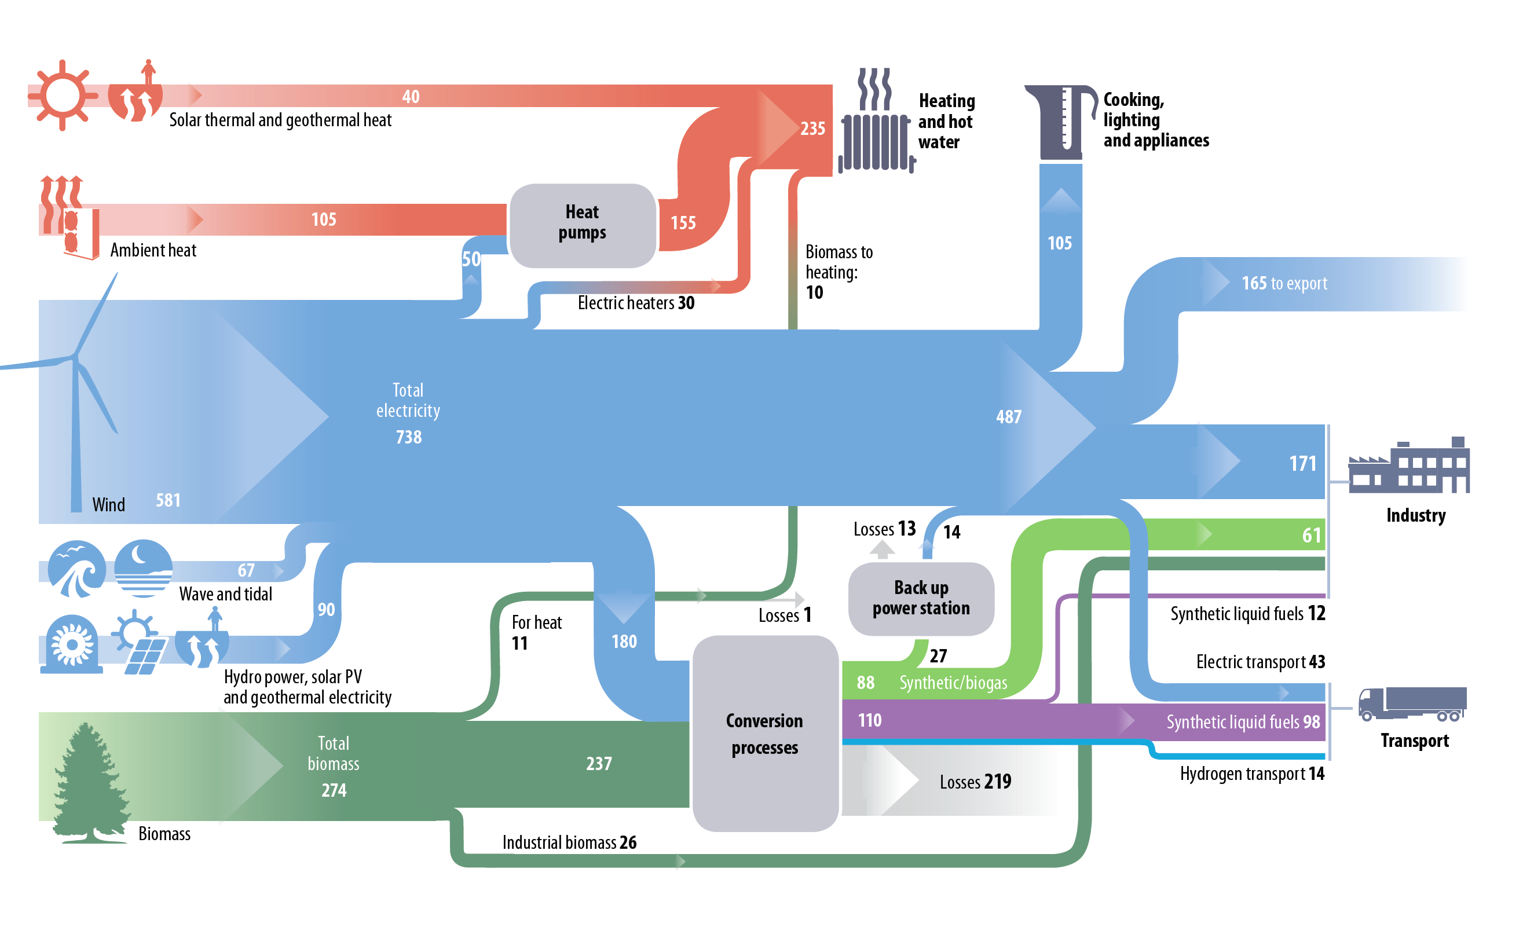
A QUICK PLUG FOR ZERO-CARBON BRITAIN
A non-fossil, non-nuclear scenario that keeps the lights on
Notes:
What we see here is the energy flow diagram for our scenario.
On the right hand side we see all the ways how we use energy – heating, appliances, industry, transport, what we’ve just discussed.
And on the left hand side we see the renewable energy sources that we use.
This is based on a thorough literature review and analysis of how much renewable energy we can produce in the UK from different sources.
So we’ve looked at how many offshore wind farms we can build, what percentage of all UK roofs we can cover in solar panels, how much wave and tidal power we can realistically harvest, to make sure that we meet the demand.
I don’t want to go into the details but just three observations:
We produce enough energy
Wind power is by far the biggest contributor – the UK has a fantastic wind resource, especially offshore
Most energy is produced and delivered as electricity
33

Slide 34
FAIRNESS
WHICH EMISSIONS SHOULD WE COUNT?
Notes:
We chose 2030 as a date by which we belive this is technically feasible

Slide 35
ALL EMISSIONS POTENTIALLY ATTRIBUTABLE TO THE UK, 1990-2050
Based on data from a study at the University of Leeds
Allowable quota

Slide 36
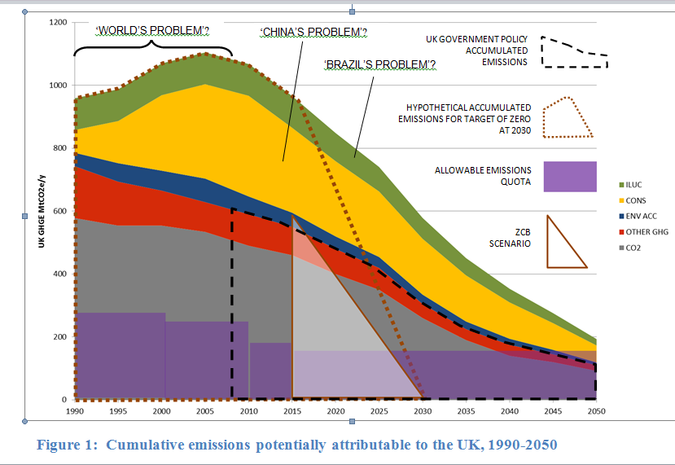
‘COMPREHENSIVE’ EMISSIONS FRAME FOR THE UK?

Slide 37
WHAT DOES ALL THIS MEAN?
Little Britain cannot save itself, much less the Planet, on its own
It cannot even pay its ‘carbon debts’ from its own territorial resources
It has to engage actively in a worldwide decarbonisation process
Most of this will be energy systems, with food and land use, and enhanced carbon sinks, playing a significant role
A bigger vision will be necessary, but it’s possible, and it could be really exciting

Slide 38
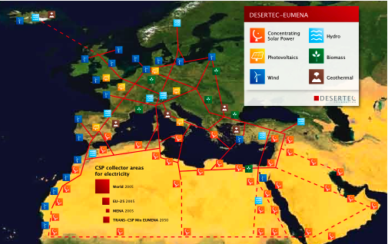

Slide 39
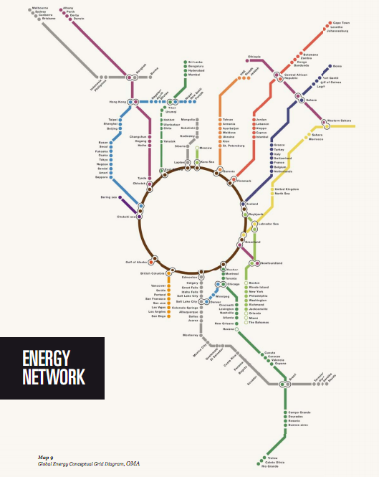

Slide 40
ALTERED RESEARCH PRIORITIES
Suspend space, particle physics → 22nd century (!!!)
Minimise need for supply by maximising energy services (efficiency/energy intensity)
Accelerated R&D in all fields of renewable energy
Energy carriers: hydrogen, e-methane, urea etc
Energy storage: batteries, thermal, cryogenic etc
Benign geoengineering: CCS, BECCS, air capture
Facilitate low-carbon lifestyles

Slide 41
A RAPID GLOBAL TRANSFORMATION
Driven by fairness, physics and sustainability
Unlikely?
Canute and Churchill agree it’s necessary
It would be rather like a war
  Because we’ve left it to the last minute
  But entirely winnable
Costs are largely irrelevant
  But it might well be financially beneficial
UK and international diplomacy vital
  The carbon attaché
  Robust systems of international carbon credits to promote transfers
Escalating international carbon price
  Removal of subsidies for fossil fuels
Leave fossil fuels in the ground
  No fracking, no further oil exploration
  Encourage fossil companies to move into renewables

Slide 42
WHICH EGGS SHOULD BE BROKEN?
These:
Higher cost
Lower energy consumption
Lots of wind, both on- and off-shore
Tidal power
Bioenergy
‘Benign geoengineering’
International energy/carbon investments
Less flying, less meat consumption

Slide 43
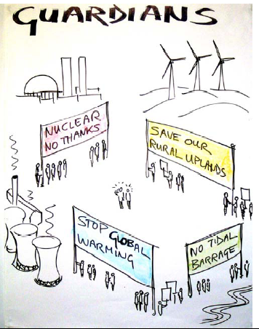
CALLING A SPADE A SPADE:
GROWN-UP DEBATES ABOUT ENERGY
...OR BIOFUELS!
...OR CARBON CAPTURE AND STORAGE!
LOTS of it!
...OR LIFESTYLE CHANGES!
Keep it cheap!
...OR GEO-ENGINEERING!
No Power Cuts!
...AND NO OFFSETS!

