Slide 1
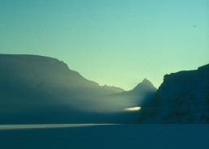
XX30191 ENERGY AND ENVIRONMENT
HOW DID WE GET HERE? Is there a distinctive
‘modern environmental problem’?
Peter Harper

Slide 2
IMPORTANT MILESTONES IN THE LAST 4.3 BILLION YEARS Linear scale
DINOSAURS (ETC) EXTINCT
DNA AND ATP
THE COMMON ANCESTOR?
BIG ORGANISMS
OXYGEN CRISIS
EARTH FORMS
PHOTOSYNTHESIS
AEROBIC RESPIRATION
THE ‘BI-CYCLE’
LIFE ON LAND?
EUKARYOTES
LIFE BEGINS
MODERN PHOTOSYNTHESIS
RUBISCO
HUMANITY
GLOBAL GLACIATION?
Plate tectonics

Slide 3
THE LAST 5 MILLION YEARS, GLOBAL TEMPERATURE CYCLES Lisiecki and Raymo 2005

Slide 4
MILESTONES FOR HUMANITY IN THE LAST MILLION YEARS
START OF CURRENT INTERGLACIAL PERIOD:
THE HOLOCENE
SPLIT FROM REST OF APES
GENUS HOMO
SERIES OF GLACIATIONS AND INTERGLACIALS
ORIGIN OF SPEECH
HOMO SAPIENS
AFRICA
PEOPLE REACH THE AMERICAS
PEOPLE REACH AUSTRALIA
VARIOUS EXTINCT HOMINID SPECIES
TIME→
WIDESPREAD EXTINCTIONS OF LARGE MAMMALS

Slide 5
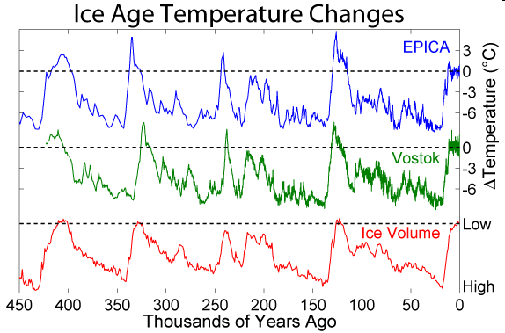
CONTEXT OF THE ‘HOLOCENE’

Slide 6
GLACIAL AND INTERGLACIAL ATTRACTORS
~-6ºC
Interglacial mean
~0ºC

Slide 7
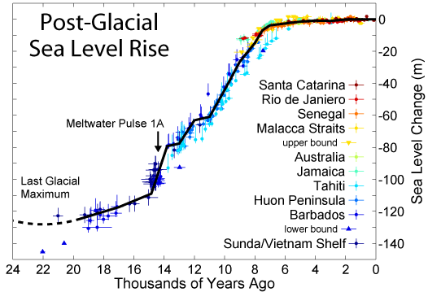
SEA LEVELS SHOW THE REMARKABLE STABILITY OF THE ATTRACTOR

Slide 8
MILESTONES OF THE LAST 10,000 YEARS The anomalously (?) stable Holocene
SINITIC CIVILISATIONS IN EAST ASIA
INCA STATE IN SOUTH AMERICA
MOST ICE SHEETS AND GLACIERS MELTED
CONTINUING SEA LEVEL RISE
SOUTH ASIAN CIVILISATIONS
RENAISSANCE EUROPE
FORMATION OF CHINESE STATE
ROMAN REPUBLIC AND EMPIRE
INDUS VALLEY
HUMAN POPULATION
N E O L I T H I C
ISLAMIC CALIPHATE
LARGELY STABLE CLIMATE WITH OCCASIONAL REGIONAL EXCURSIONS
MESOPOTAMIAN CITY STATES
CLASSICAL GREECE
INDUSTRIAL REVOLUTION IN EUROPE
EGYPTIAN CIVILISATION
OLMEC/TOLTEC CULTURES MESOAMERICA

Slide 9
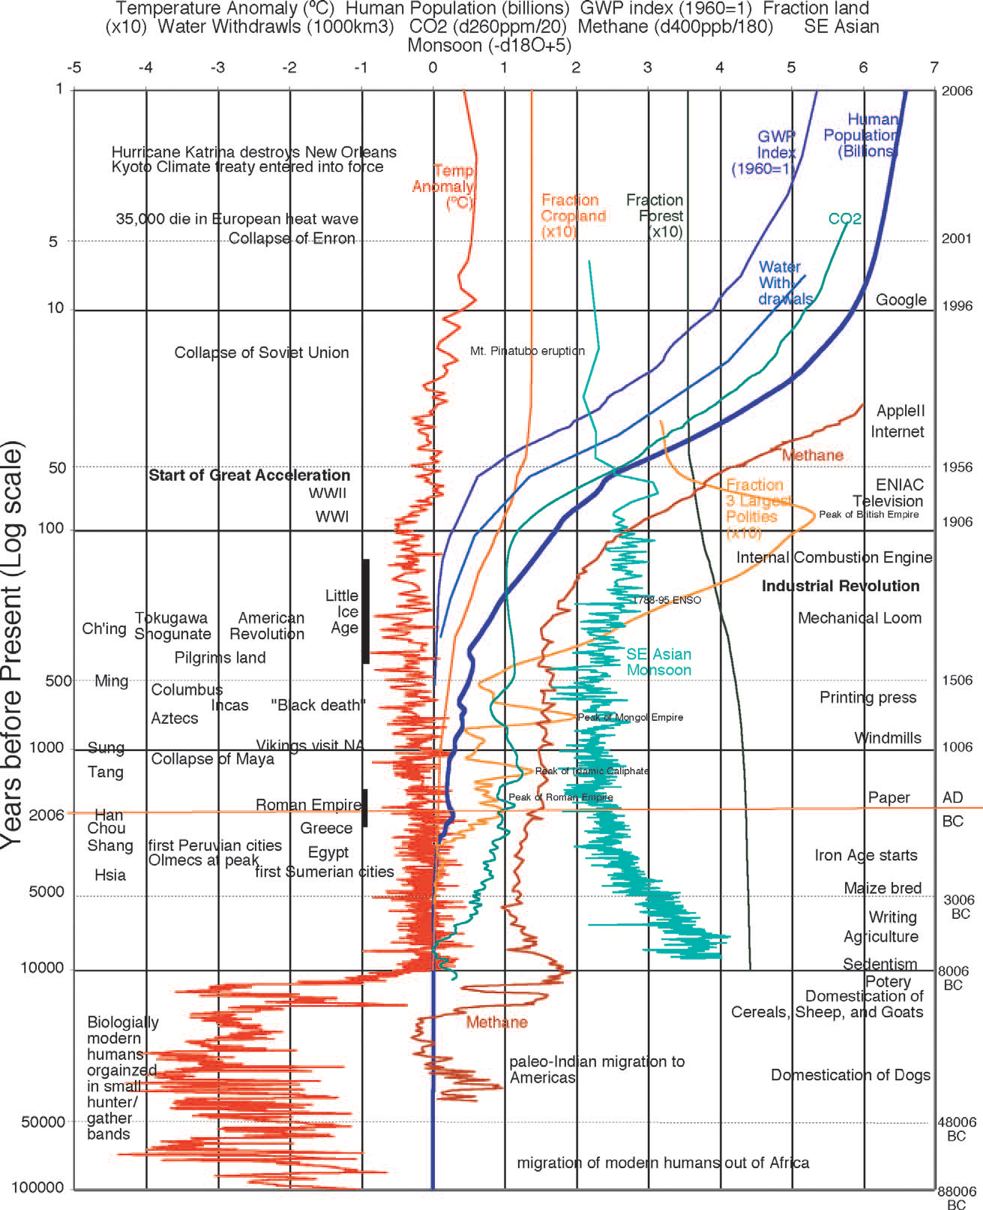
“GREAT ACCELERATION” ADVENT OF THE ‘ANTHROPOCENE’ NB Log scale
Industrial culture
Agricultural civilisations
Hunter-gatherers
Costanza et al., 2007

Slide 10
3 KINDS OF HUMAN SOCIETY
Each having its own kinds of environmental impacts
Hunter-gatherer/pastoral (many examples)
Nomadic, clan-based, unspecialised, cyclical
Tend to be displaced by farmers
Agrarian civilisations (a dozen or so examples)
Strong links to territory, hierarchical, specialised, slow directional change and technical development, record keeping
Most eventually collapse, often for environmental reasons
Industrial cultures (only one example)
Large variety of environmental impacts
So far not irreversible
‘Traditional’ or pre-modern
‘Modern’

Slide 11
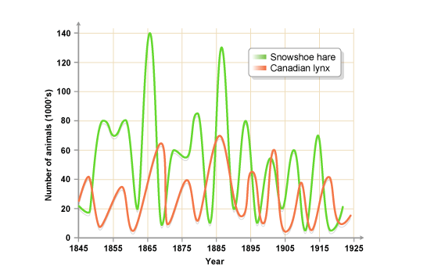
Are hunter-gatherers like animals? Large population fluctuations regulated by prey dynamics? Probably not

Slide 12
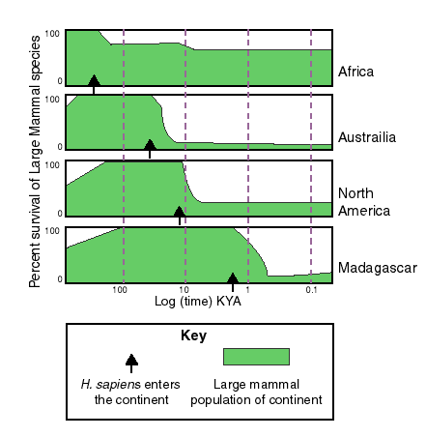
TIMING OF MEGAFAUNAL EXTINCTIONS -- complete coincidences? From P.S. Martin and G.Klein, Quaternary Extinctions, U. of Arizona Press, 1984

Slide 13
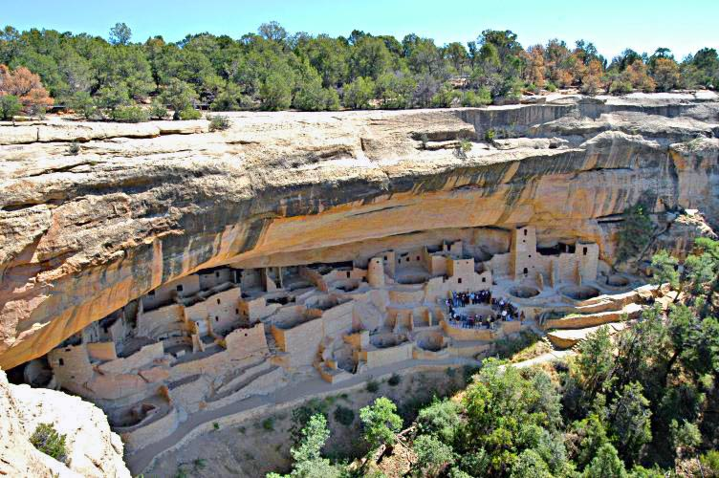
Collapse of an agrarian culture Analysed by Jared Diamond, Collapse, 2005
‘Anasazi’ settled agricultural culture established ~600AD
Over-exploited local resources of timber, leading to deforestation, and necessitating more and more distant sourcing
Irrigation channels became progressively eroded
Growing stress and complexification, exploitation of surrounding communities
Unable to survive later drought periods

Slide 14
IS THERE A COMMON PATTERN HERE?
Pressure to exploit an available resource, without any particular limit
Failure to anticipate or mitigate unsustainable levels of exploitation
Often on account the conflict between narrow short-term and collective long-term interests
A celebrated case is “The Tragedy of the Commons”
A significant source text by Garret Hardin
(Science, Vol.162, p.1243, December 13, 1968)

Slide 15
ALTHOUGH THERE ARE ALWAYS COUNTERVAILING FORCES
Humans don’t want to be like natural populations
Most contemporary hunter-gatherer societies have achieved a good balance with their natural environment
Environmentally functional ‘culture’ important
The ‘grazing commons’ were in fact carefully regulated
This is broadly ‘politics’: the process of trying to optimise collective resources
And you can dimly see the archetypal ‘left’ and ‘right’ perspectives

Slide 16
DISTINCTIVE FEATURES OF ‘MODERNITY’
An unplanned and unprecedented experiment
Options and impacts greatly amplified through scientific technology and cheap energy
Food supply amplified by industrial nitrogen
Much larger population than ever before
Options and impacts greatly amplified through scientific technology and cheap energy
Rapid change driven by technical innovation
Continual emergence of unexpected effects
High capacity to break through natural limits
Also greater capacity to foresee and forestall problems
Does it make serious and irreversible environmental problems more, or less, likely?

Slide 17
‘EXPERT OPINION’ IS SHARPLY POLARISED This is rather surprising, but has great significance
‘Prophets of Doom’ Modernity is problematic. There are real limits; we must respect them; limit demand, redistribute; proceed cautiously
 | Early publication | Later Publication
P. Ehrlich | 1968 | 1997, 2008
B. Commoner, | 1972 | 1990
D. Meadows et al | 1972 | 1992, 2004, 2012
E. Goldsmith | 1972 | 1997
‘Prophets of Boom’ Modernity is an unalloyed good. There are no limits to imagination and technological advance; no need for limitation, caution or redistribution
 | Early publication | Later publication
H. Kahn | 1967 | 1984
J. Maddox | 1972 | 1998, 2009
W. Beckerman | 1974 | 1995, 2002
J. Simon | 1977 | 1994
Adapted from Harper, 2000

Slide 18
(Some) SCIENTISTS VS. (some) ECONOMISTS Natural and human capital
Generally scientists emphasise the primacy of ‘natural capital’ (all the resources of the natural world)
While economists (and politicians, and most others) emphasise ‘human capital’ (ingenuity, new technology, money, regulations, intelligent organisation)
The argument is whether, if there is a lack of natural capital, it can always be made up by human capital
“You can’t get a quart out of a pint pot”
“Oh yes you can, if you are smart enough”
It is still a live debate

Slide 19
‘OPTIMISTIC’ VIEWS AND REASONING
Affluent societies have a genuine interest in environmental quality, and are usually willing to pay for it, at least to a modest extent
This is a change from pre and early-modern societies
‘Spontaneous’ background trends are often benign
There is high capacity for analysis of problems, and for rapid technological progress in mounting solutions
Most physical environmental problems are readily solved, and there have been many genuine successes

Slide 20
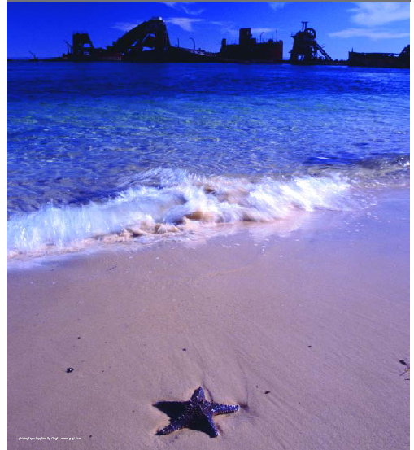
DO YOU LIKE THE VIEW?

Slide 21
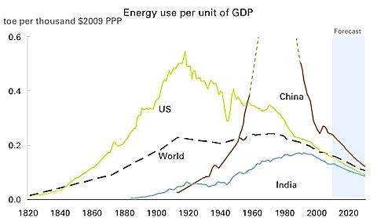
THE ‘ENVIRONMENTAL KUZNETS CURVE’ (EKC) “Automatic”reductions in environmental intensity (energy, carbon, etc)
Source:
theregister.co.uk

Slide 22
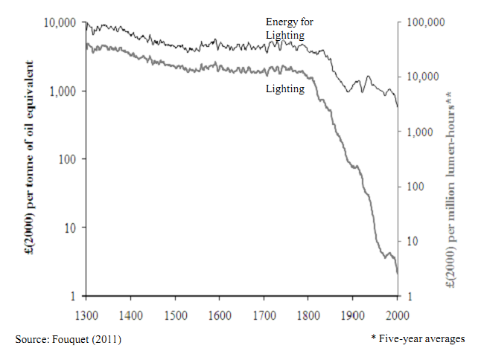
RATE OF TECHNICAL ADVANCE CAN BE RAPID AND DELIVER VERY DRAMATIC INCREASES IN EFFICIENCY COST OF LIGHTING 1300-2000 (From Fouquet, 2011)
‘Factor 10’ in energy
>3 orders of magnitude in lighting efficacy

Slide 23
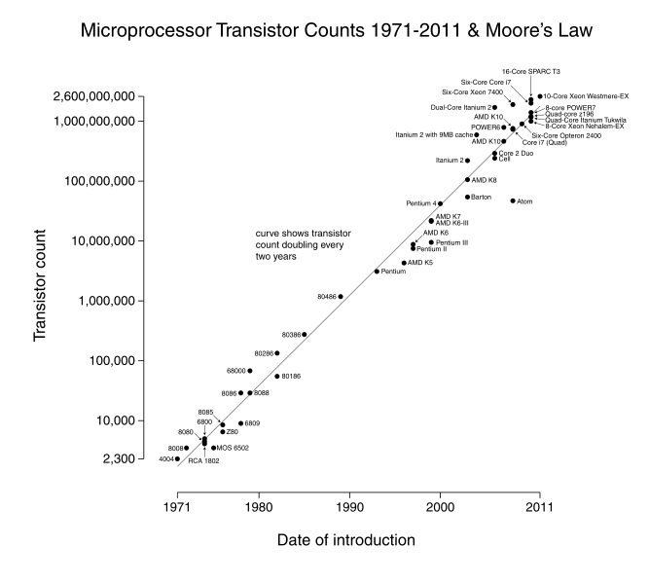
MOORE’S LAW Still going strong
‘Factor 10’ every 7 years
Image credit: wikipedia.

Slide 24
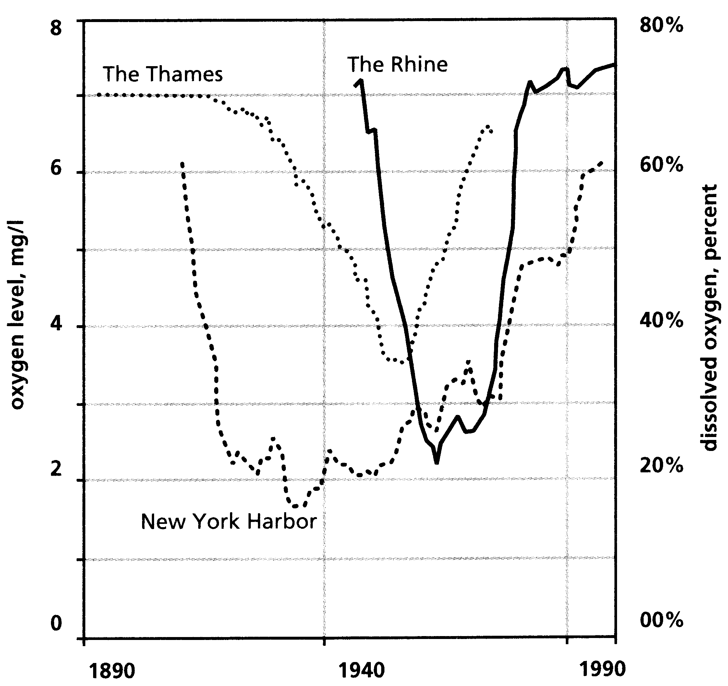
LOCAL ENVIRONMENTAL PROBLEMS CAN USUALLY BE SOLVED (AT A PRICE) BY REGULATION AND TECHNICAL MEASURES

Slide 25
STANDARD ‘B.A.U.’ MODEL OF MITIGATION PROCESSES
UK air quality
Lead in petrol
Protection of peatlands
Acid rain
Eutrophication of lakes
Toxic materials in paints
Bathing water quality
Protected areas
Stratospheric ozone
Extrapolated trend
ENVIRONMENTAL IMPACT (NOTIONAL ARITHMETIC SCALE)
Outcome
Trend identified
Mitigation measures

Slide 26
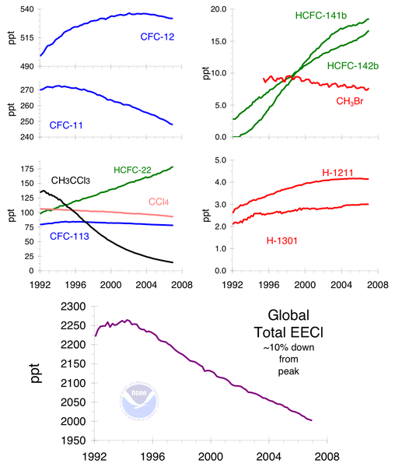
EFFECTS OF THE MONTREAL PROTOCOL ON OZONE-DETROYING CHEMICALS
Even global problems can be solved with appropriate regulatory framework and shifts in technology

Slide 27
‘THE ENVIRONMENTAL LITANY’ according to Bjørn Lomborg (an economist), and his replies
The world’s ecosystems are breaking down
Resources are running out
The population is ever growing
Air and water are becoming more polluted
More and more species are becoming extinct
Forests are disappearing
Coral reefs are dying
Fish stocks are collapsing
Top soil is disappearing
Deserts are growing
Wilderness is increasingly destroyed
The climate is changing irreversibly
…….
WHAT DOES THIS MEAN? THEY ARE ALWAYS CHANGING ANYWAY
SOME MIGHT BE, BUT WE FIND MORE, SUBSTITUTE
BUT THE GROWTH IS SLOWING DOWN
WHERE? CERTAINLY NOT IN THE UK
NOT MANY CONFIRMED CASES
THEY ARE INCREASING IN TEMPERATE AREAS
SOME ARE, BUT CAN RECOVER
SOME ARE, BUT CAN RECOVER
BUT THERE’S STILL PLENTY
THIS IS DISPUTED, THEY GROW AND SHRINK
DEPENDS WHAT YOU MEAN BY…AND WHO NEEDS IT?
CAN YOU PROVE IT?
BAD FOR SOME, GOOD FOR OTHERS: AND WE CAN FIX IT

Slide 28
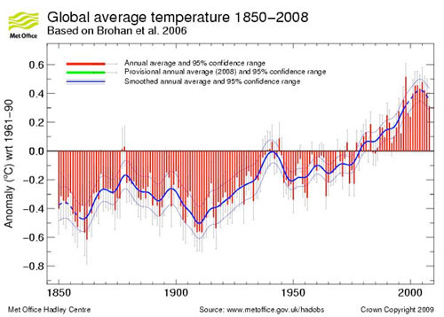
IS IT ACTUALLY WARMING? AT WHAT POINT CAN YOU SAY ‘THIS IS ENOUGH EVIDENCE TO TURN THE WORLD ECONOMY ON ITS HEAD’?
D
D

Slide 29
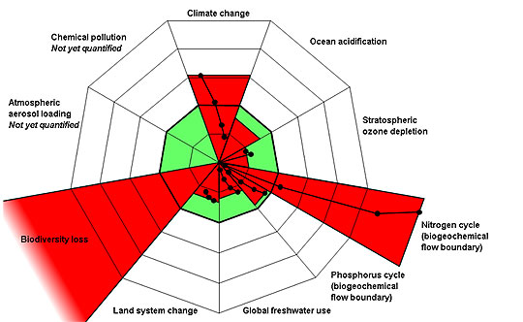
RECENTLY THE ‘LITANY’ HAS BEEN RE-ANALYSED AND PARTIALLY QUANTIFIED IN THE FORM OF ‘PLANETARY BOUNDARIES’ BUT THIS TOO REMAINS CONTROVERSIAL
Rockström et al., 2009

Slide 30
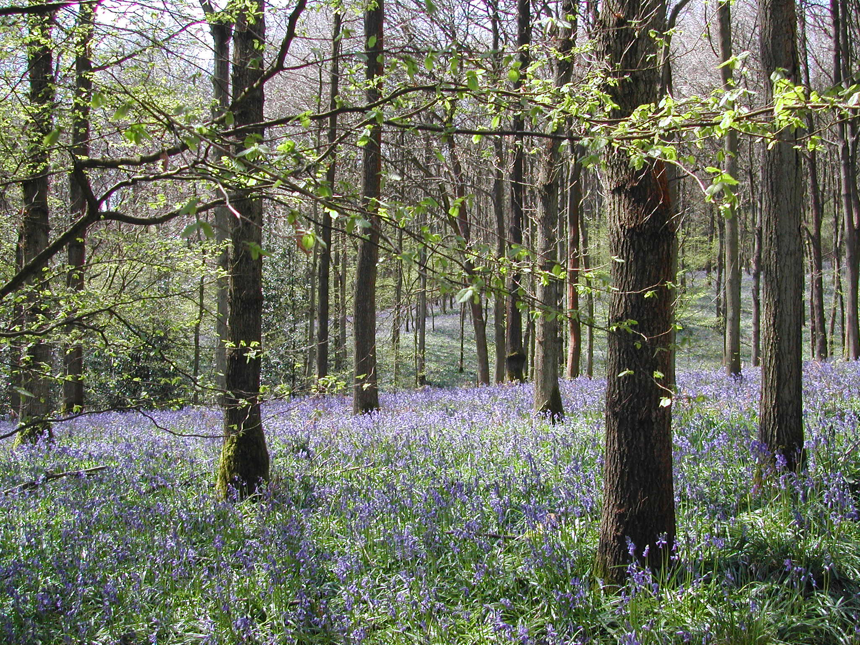
BUT THE BASIC THINKING GOES BACK 60 YEARS. SOME MILESTONES IN ENVIRONMENTALISM
‘Neo-Malthusian’ recognition of implications of exponential population growth 1950s
Silent Spring 1962: technology, biodiversity
Friends of the Earth1968: generalising local issues
The Limits to Growth 1972: highlighting global issues
UNCHE, Stockholm 1972: UNEP
The ‘Precautionary Principle’ 1982
Brundtland Report 1987: Sustainable Development

Slide 31
FURTHER MILESTONES IN ‘ENVIRONMENTALISM’
Montreal Protocol 1987: ozone-depleting substances
‘Rio 1992: UNFCCC, UNCBD
IPCC and Assessment Reports 1991-2013
1990s: Climate change as an emblematic and overarching problem
Kyoto Protocol 1997/2005
The Millennium assessment of Ecosystem Services 2005
‘Planetary Boundaries’ including climate change 2009

Slide 32
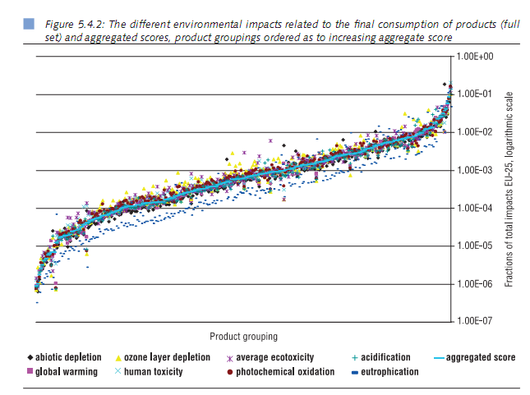
CLIMATE CHANGE REMAINS THE PRINCIPAL GLOBAL PROBLEM, AND CARBON EMISSIONS CORRELATE WELL WITH OTHER ENVIRONMENTAL IMPACTS

Slide 33
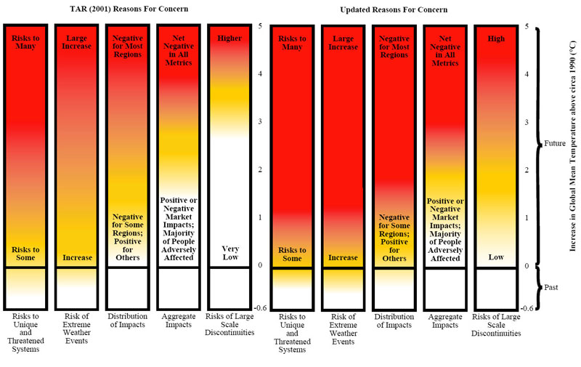
THE PROBLEM IS DEEPENING and 2°C is already ‘dangerous’

Slide 34
WHAT MIGHT THIS MEAN FOR THE HOLOCENE ATTRACTOR?
~-6ºC
Interglacial mean
~0ºC

Slide 35
THE “MISANTHROPOCENE”
EVENTUAL WORST-CASE?
EXTREMELY UNPREDICTABLE WEATHER
INTOLERABLE PROBLEMS SPREADING FROM THE TROPICS
COLLAPSE OF THE INTERNATIONAL ORDER AND MANY STATES
BILLIONS OF DEATHS
BIOSPHERIC MASS EXTINCTION EVENT
Holocene mean
+6ºC

Slide 36
THIS REMAINS SPECULATION
The potential risks are severe, but widely disputed
The pattern of future climate sensitivity remains uncertain
What does the ‘precautionary principle’ mean in this context?
What are the possible later outcomes of various future pathways?
Which futures should we prepare for?
Do we have choices?

Slide 37
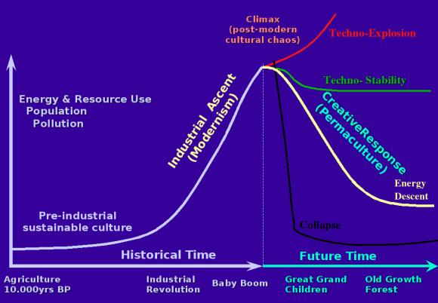
DAVID HOLMGREN’S VERY BIG PICTURE http://www.youtube.com/watch?v=7etwG7ojxEI.
…and my unauthorised amendments
Mainstream
choices
Non-conventional choices

Slide 38
THE SCIENTIFIC CONSENSUS ON CLIMATE CHANGE IS VIRTUALLY COMPLETE, BUT THIS HAS FAILED TO TRANSLATE INTO EFFECTIVE MITIGATION
Elite vs populist and left vs right polarisation.
‘Climategate’ was a key indicator that scientific evidence is a minor factor.
UNFCCC COPs at Copenhagen, Cancun, Durban failed to produce useful consensus
Institutionalised ‘denialism’ is now a major influence in the debate
Probably demands a complete change of strategy from the ‘mitigationist’ community
Note important contrast between mitigation and adaptation

Slide 39
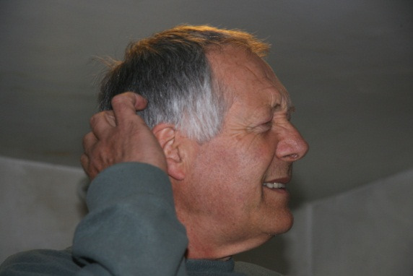
SUCCESSFUL MITIGATION
THE HOLOCENE
THE NEO-HOLOCENE
THE ANTHROPOCENE
FAILURE OF MITIGATION
THE MISANTHROPOCENE
THE END?

