Slide 1
Digital microscope video clips

Slide 2
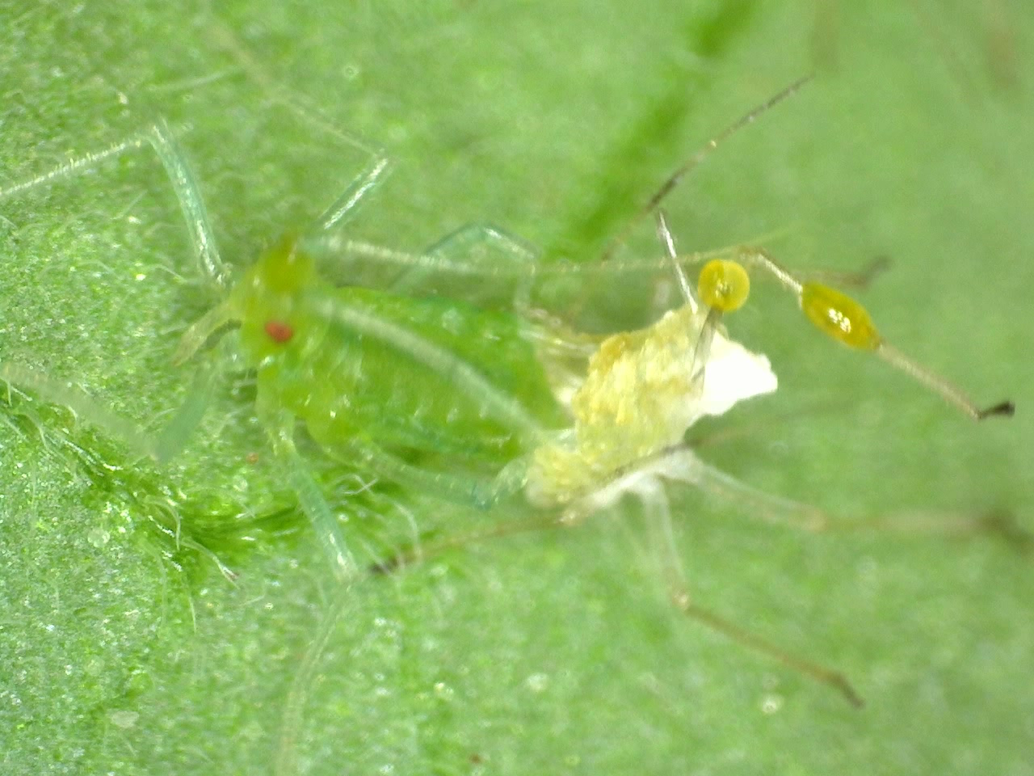
Aphid emerging from exoskeleton
(video clip).
After emergence they are soft and grow quickly
Notes:
Click on the ‘start movie’ triangle
The yellowy blobs might be wax secretions from the cornicles, thought to deter predators

