Slide 1
IMAGES FROM A PEST-CONTROL PRACTICAL CLASS Using a mounted digital microscope
Collated by Peter Harper
CAT/GSE MSc SF&NR
July 2018
Notes:
Students collected these specimens and then took images using the digital microscopes.

Slide 2
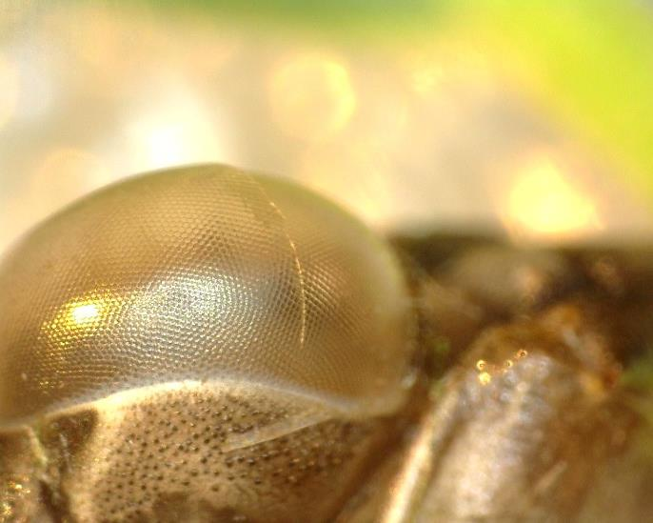
Eye of a dragonfly larva exoskeleton
Notes:
Insects have a hard exoskeleton that prevents them growing. So from time to time they shed the skeleton, grow quickly and create a new one. The old skeleton or ‘exuvia’ is a remarkably exact model of the organism, as can be seen from the eye detail here.

Slide 3
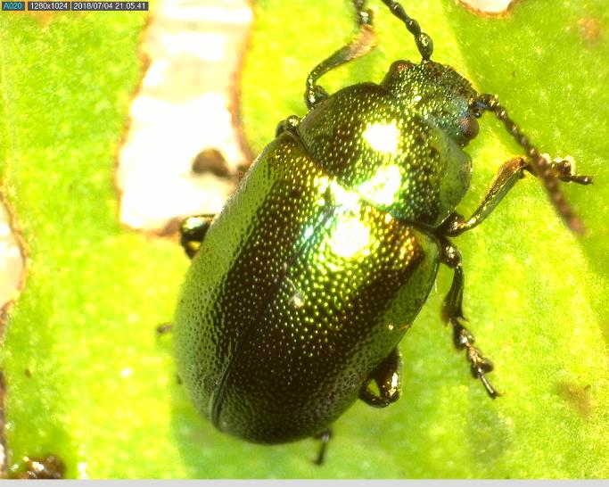
The golden dock beetle Gastrophysa viridis
Notes:
The golden dock beetle lays yellow eggs that hatch out into voracious black grubs, who eat dock leaves. They can be an significant control element for the rather aggressive dock plants. No eggs or grubs were found on this occasion.

Slide 4
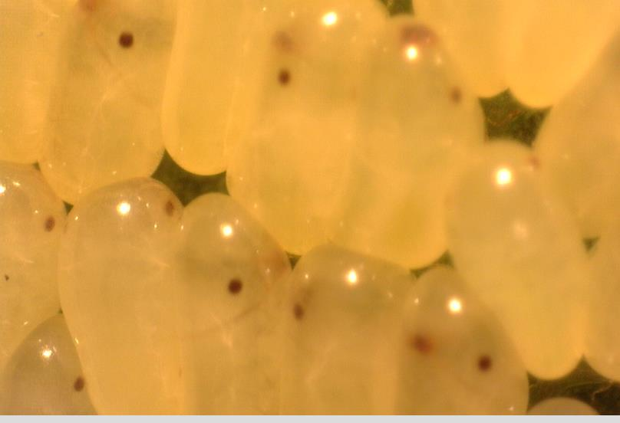
Unknown eggs with larvae ready to hatch (eye-spots visible)
Notes:
I could not identify these eggs.

Slide 5
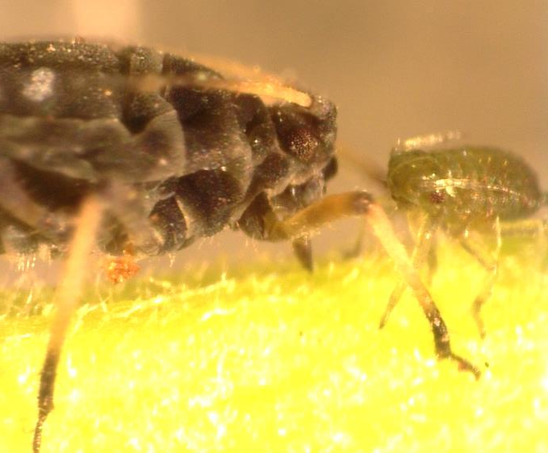
Two aphids feeding
Stylets – sucking mouthparts
Notes:
In this image you can see the typical feeding behaviour of aphids, with the stylets inserted into the phloem stream below the plant surface

Slide 6
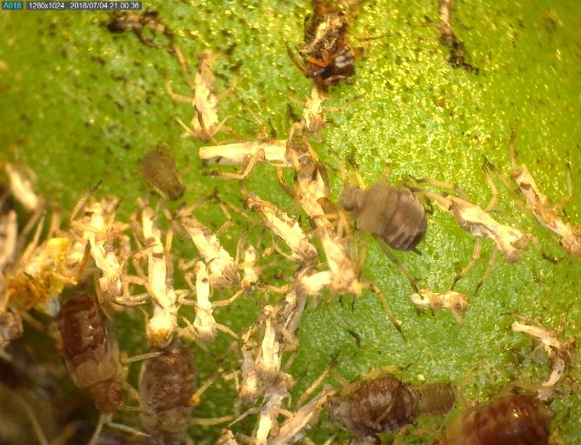
Exuviae and predated corpses
Predated, usually black or brown
Cast exuviae white
Live aphids all colours and fat

Slide 7
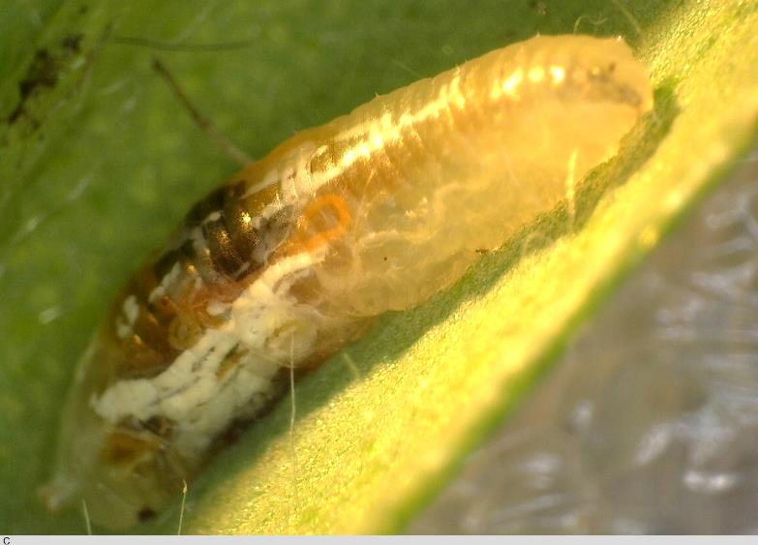
Mature hoverfly larva, close-up
Notes:
Hoverfly larvae are white or semi-transparent, and you can usually see dark bits of previous meals inside. This one is large and probably ready to pupate. The pupae are pear-shaped, white or tan-coloured, and attached to a stem or leaf. Leave them be.

Slide 8
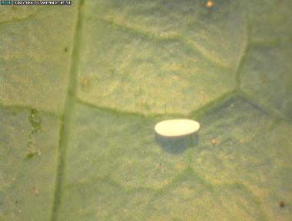
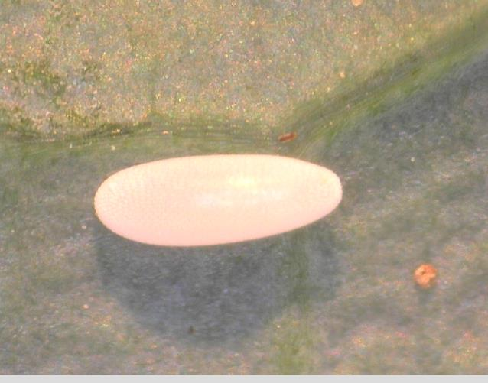
Hoverfly egg Your friend – do not remove!

Slide 9
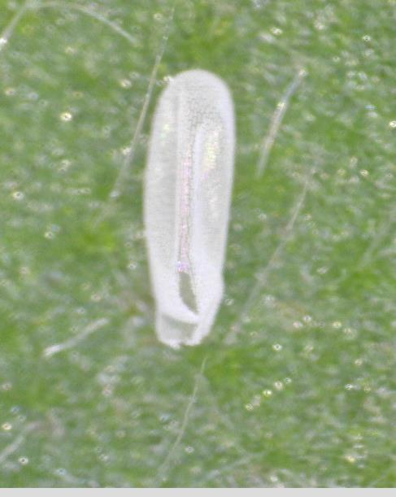
Empty egg-case of a hoverfly larva

Slide 10
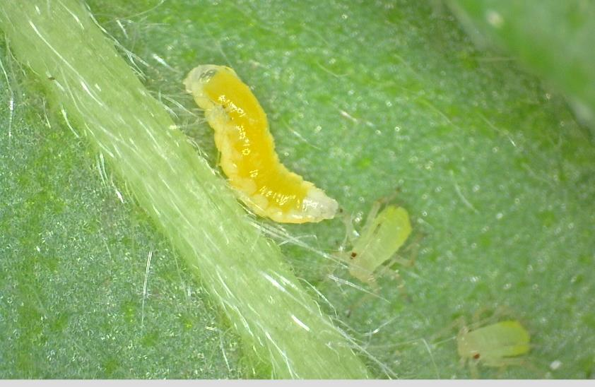
Gall-midge larva approaching an aphid with intent Encourage anything that’s orange!

Slide 11
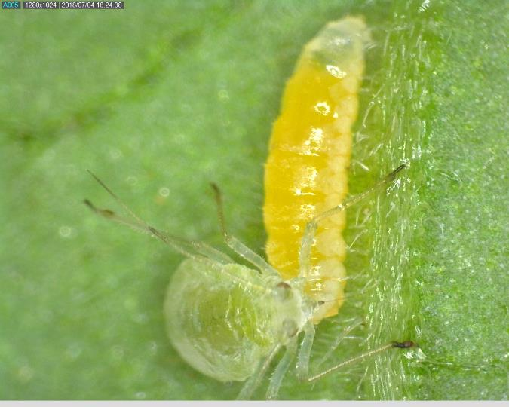
Gall midge larva sucking out the contents of a green aphid
Notes:
After this kind of predation, aphids are naturally smaller and look ‘crumpled’, as you might expect.

Slide 12
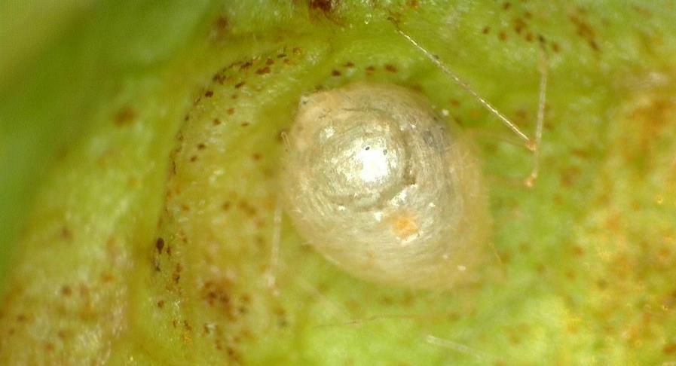
Parasitised aphid ‘mummy’. Wasp already hatched, flap closed We did not catch any wasps either laying or hatching. Perhaps next year!
Notes:
The holes are perfectly round, which they need to be if the ‘flap’ is to open properly. This implies a specific neural program in the adult wasp before emergence. How does it do it?

Slide 13
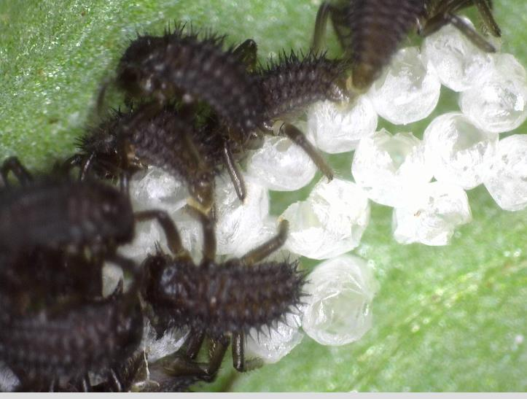
Ladybird larvae emerging from their eggs
Notes:
These are larvae of the now-ubiquitous invasive harlequin ladybird. They do the same ecological job as native ladybirds. These larvae are carnivorous and consume aphids readily.

Slide 14
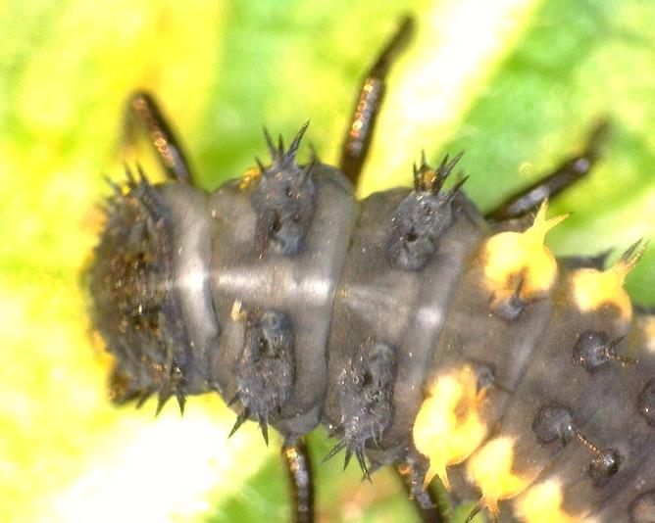
Head of a ladybird larva

Slide 15
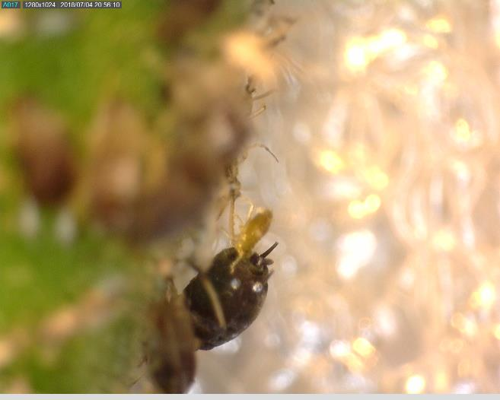
Baby aphid being born

Slide 16
Moment of birth video clip
Note the blobs of excreted ‘honeydew’, commonly removed by ants
Notes:
It is mildly amusing that aphids are born bum-first and not head-first like mammals.

Slide 17
THE END
Notes:
No comment

