Slide 1
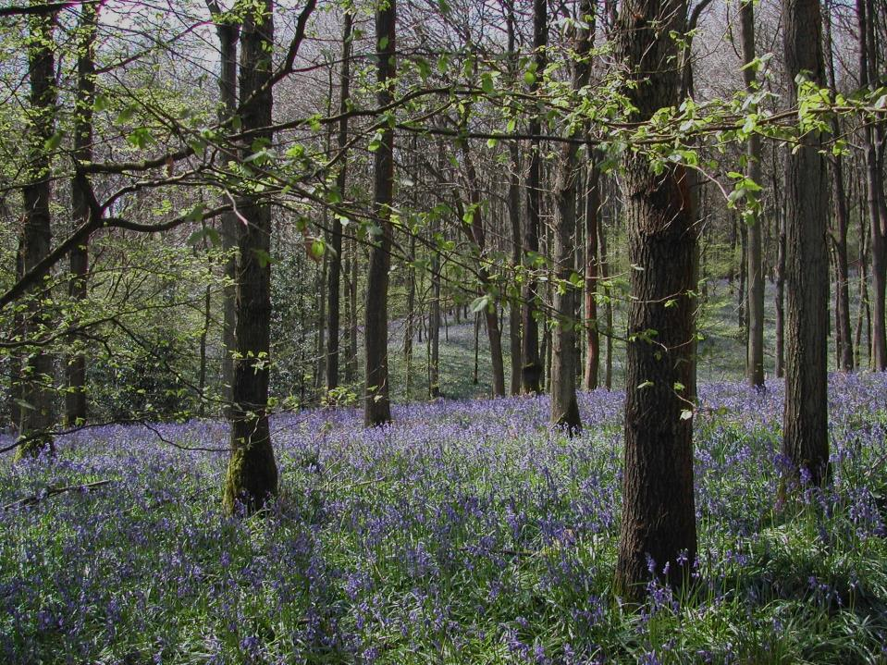
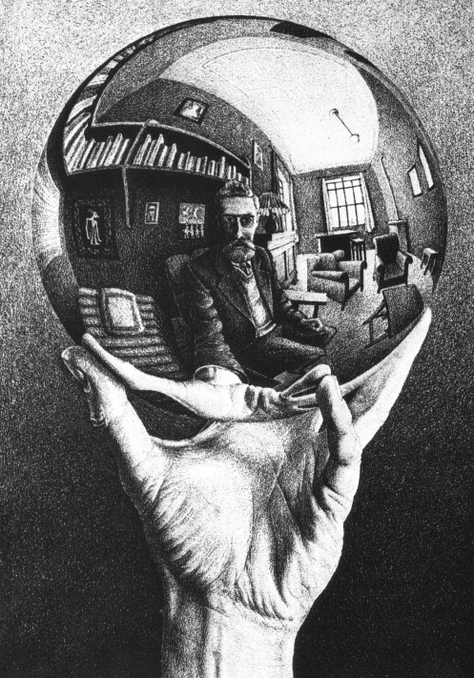
IS NATURE REALLY NATURAL?

Slide 2
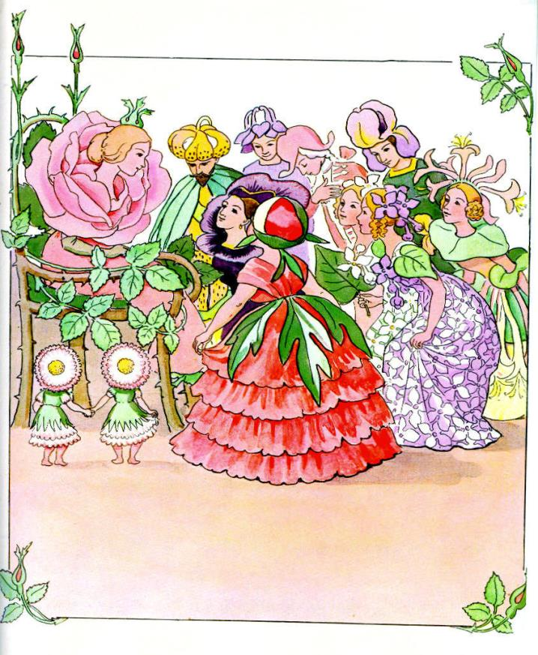

Slide 3
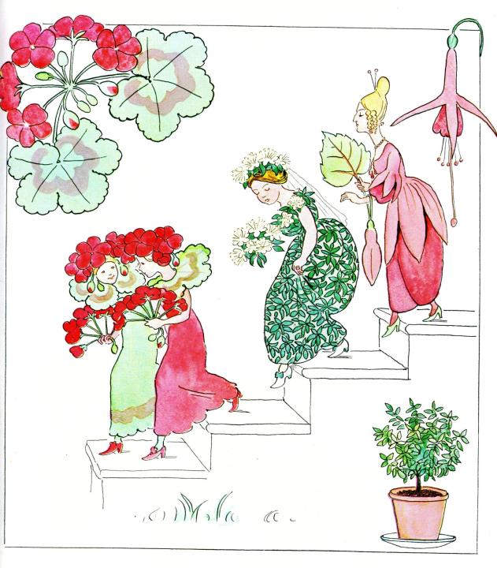

Slide 4
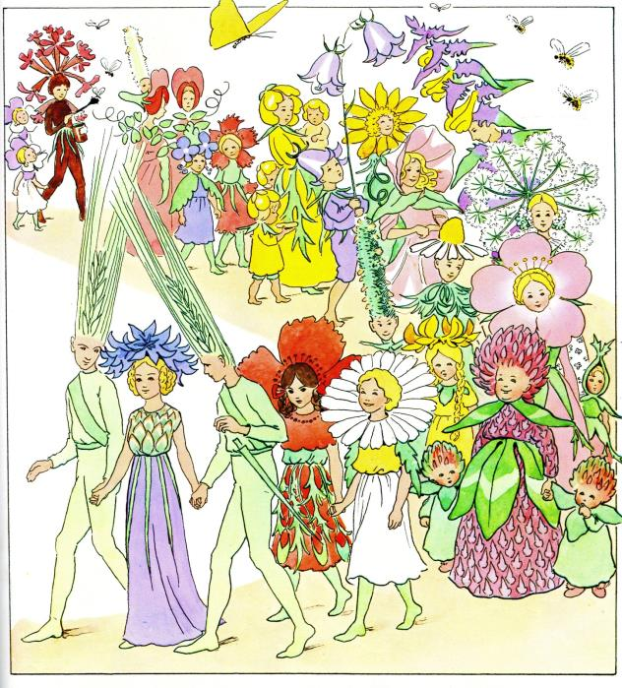

Slide 5
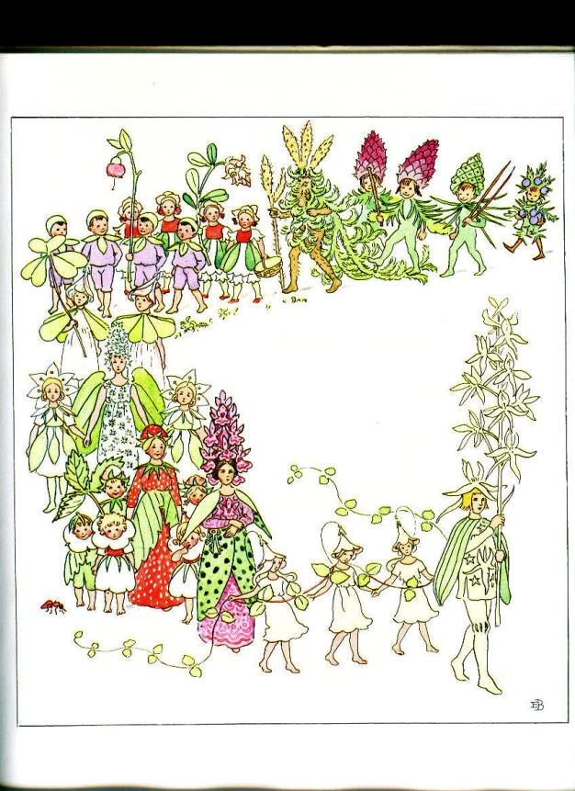

Slide 6
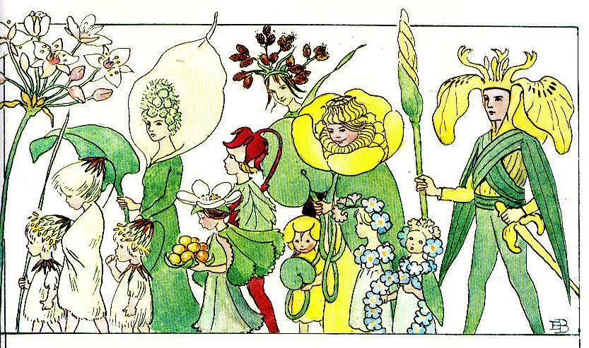

Slide 7
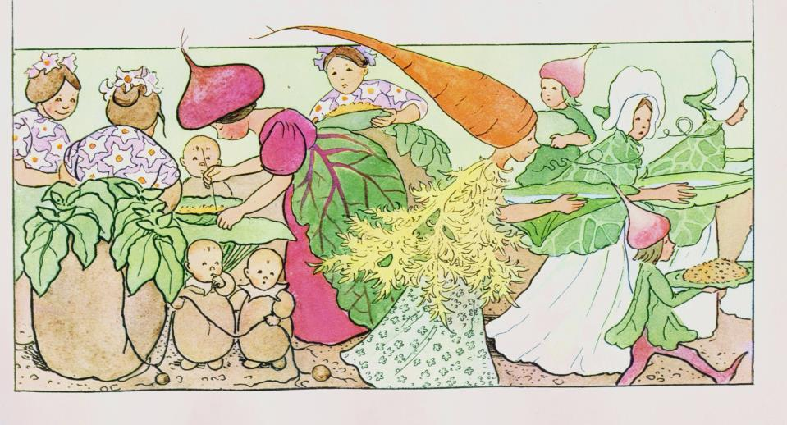

Slide 8
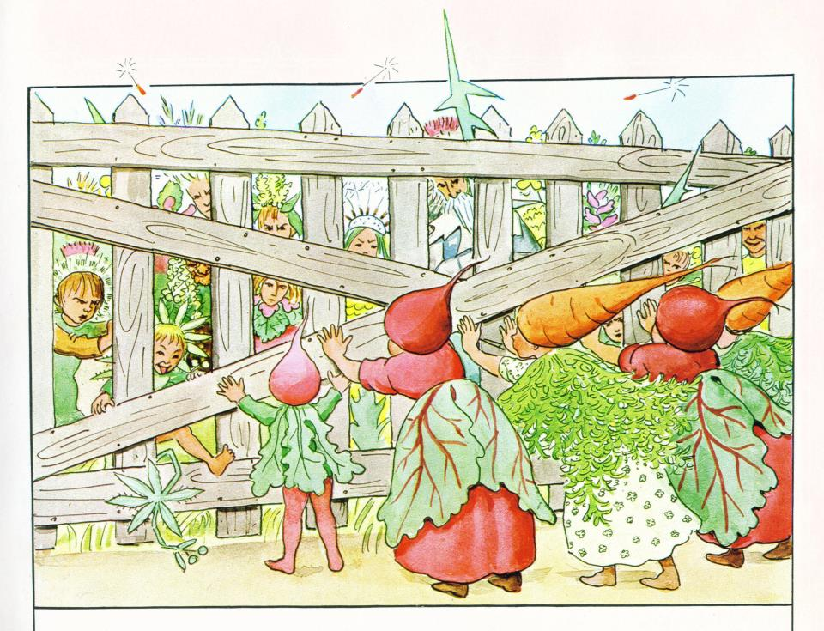

Slide 9
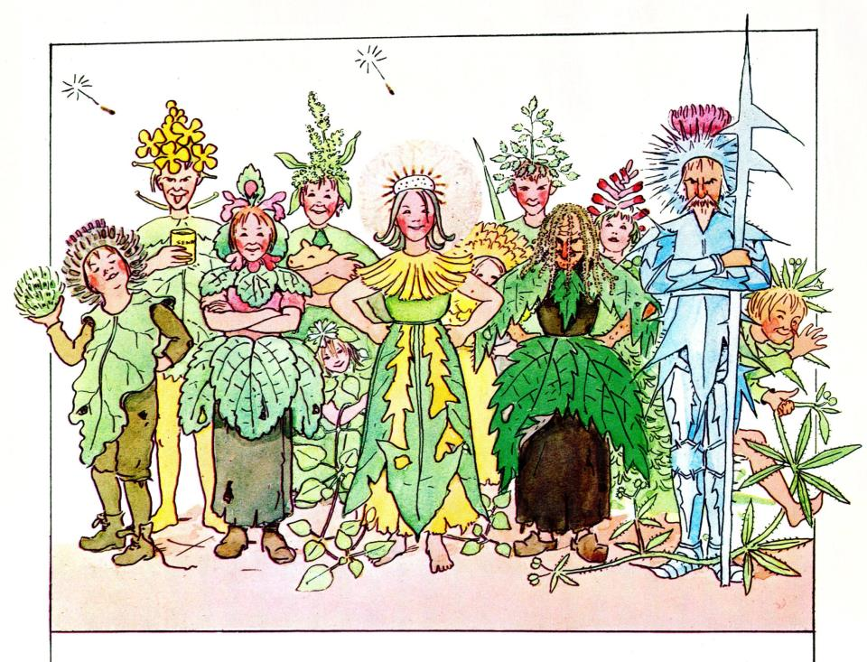

Slide 11
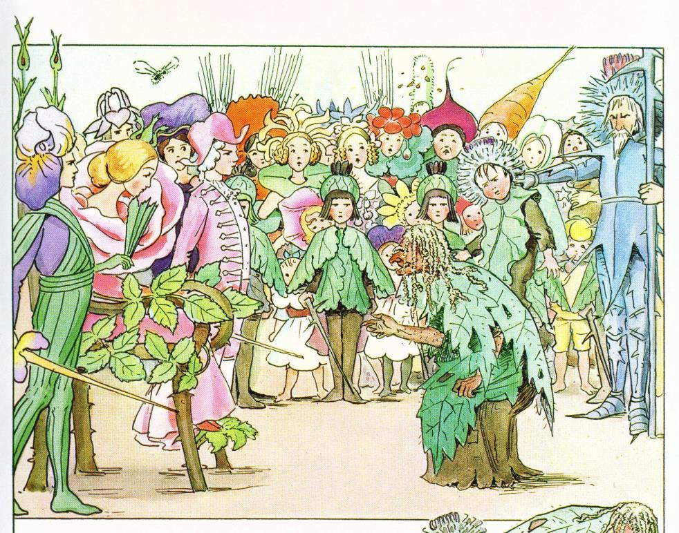

Slide 12
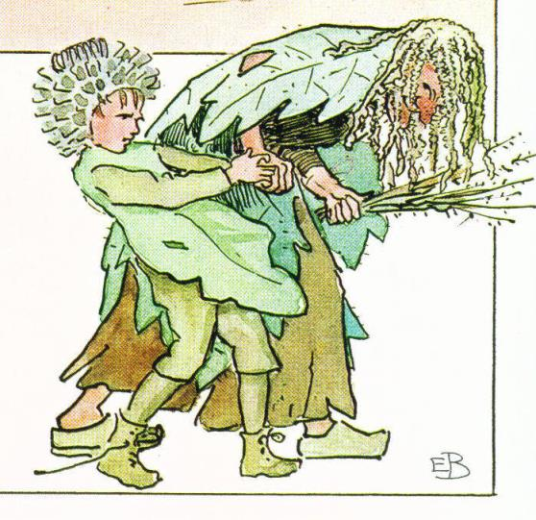

Slide 13
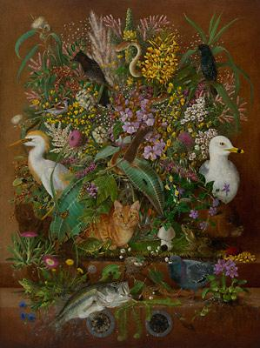
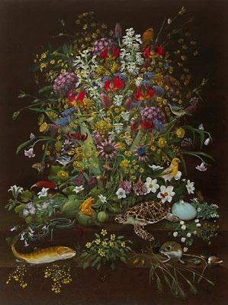
Ascendant and descendant species. Isabella Kirkland

Slide 15
CLASSIFYING THE LIVING WORLD
Starts very ‘natural’…
…that is to say, unnatural!
We gradually struggle to escape religious doctrine, ideology, projection of human society onto Nature

Slide 16
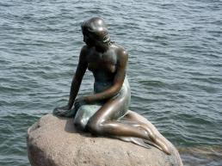
JORGE LUIS BORGES’S IMAGINARY CLASSIFICATION OF A CHINESE BESTIARY
BELONGING TO THE EMPEROR
FABULOUS
MERMAIDS
EMBALMED
APT TO WAVE THEIR TENTACLES LIKE MADMEN
DRAWN WITH A FINE CAMELHAIR BRUSH
LOOKING FROM A DISTANCE LIKE FLIES

Slide 17
The Eternal, That which IS
Powers
Dominations
Virtues
Choirs of Angels
Cherubim
Seraphim
Archangels
Angels
Man
monkey
Quadrupeds
flying squirrel
bat
ostrich
Birds
amphibious bids
aquatic birds
flying fish
Fish *(include tortoise, crocodile, sea lion, hippo, whales)
eels and creeping fish
water serpents
Reptiles
slugs
Shellfish
crab
crayfish
pond mussel
lime-secreting worms
THE GREAT CHAIN OF BEING
Insects (including lizards and frogs!)
worms
polyps
Plants sensitive plants
trees
shrubs
herbs
lichens
moulds
mushrooms
truffles
Stones
composed of layers, fibres and filaments
unorganised stones
Crystalline salts
vitriols
Malleable metals
Non-malleable metals
sulphur and bitumens
compound earths
Pure earth
Water
Air
Etherial matter

Slide 18
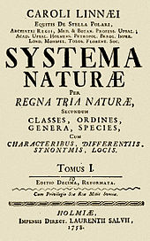
LINNAEUS: Two Kingdoms PLANTS AND ANIMALS Vertebrates 4, Invertebrates 1

Slide 19
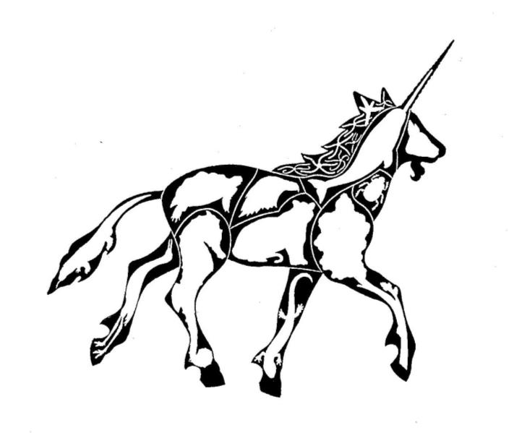
MARY BARTLETT, a practicing Linnaean? Vertebrates 8, Invertebrates 2, Plants 1
3 mammals
2 birds
2 reptiles
1 amphibian
1 fish
I arthropod
1 echinoderm

Slide 20
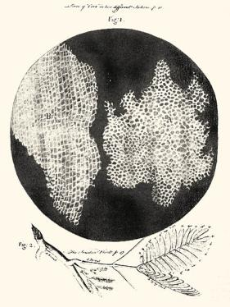
THE MICROSOPIC REVOLUTION
Leeuwenhoek and Hook revealed the amazing variety of the microworld
Compare Galileo’s discovery of the moons of Jupiter
This was not mentioned either by the ancients or in Holy Scripture, and it was ‘obvious’ they did not know about it
Therefore neither could be regarded as a source of ‘truth’ or a superior way of interpreting the world
What else then? Observation, tests, consilience…the fatal cracking of the code?

Slide 21
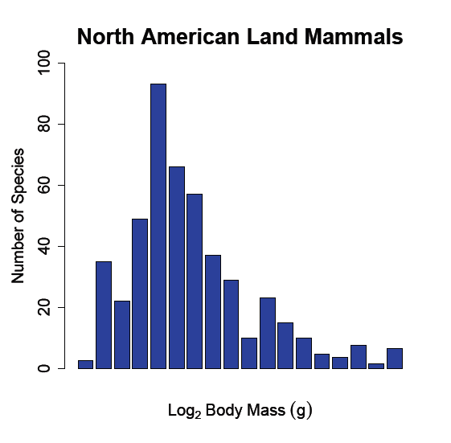
RANK SPECIES IN ORDER OF SIZE

Slide 22
Me at school: still two kingdoms, and matching subjects, but the worms turn: Vertebrates 1, Invertebrates 1
Size of textbooks is equal
Vertebrate Classes now split amphibians and reptiles
‘Chain of Being’ hierarchy morphs into the evolutionary tree: invertebrates → fish → amphibians → reptiles → birds → mammals

Slide 23
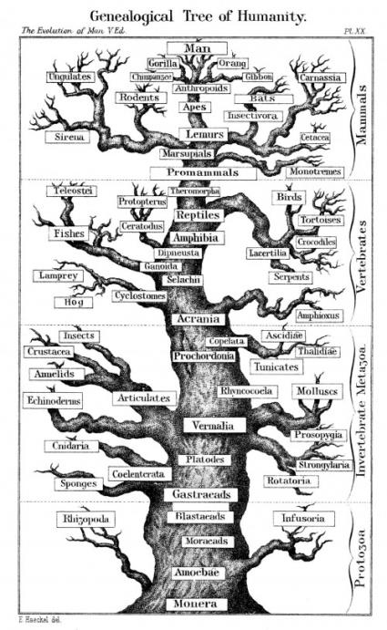
HAECKEL’S TREE

Slide 24
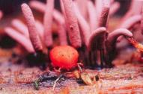
Me in a Zoology Department in the early 1960s THE ANIMAL PHYLA Invertebrates ~20, Vertebrates <1
Still only two kingdoms
‘Protozoa’ are honorary animals (Zoology Dept)
Fungi are plants and ‘Bacteria’ and ‘viruses’ are honorary plants (Botany Department)
Still looking for a ‘natural’ classification

Slide 25
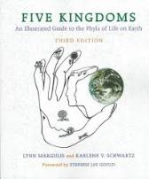
THE FIVE KINGDOMS OF LYN MARGULIS Bacteria, Protoctista, Fungi, Plants, Animals
Breath of fresh air?
A useful functional classification
The prokaryote/eukaryote distinction increasingly recognised as fundamental
‘Two domains’ seems better
Then we realised there are two ‘kingdoms’ of bacteria!
Finally…(?) we have three-domain system based on statistical genetics

Slide 26
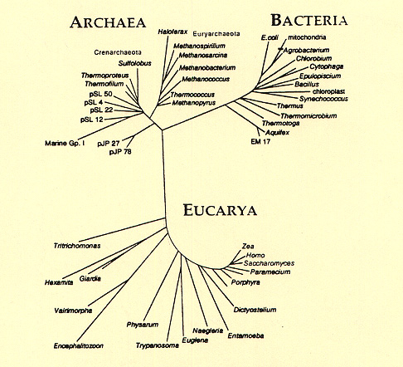
For He hath put down the mighty from their seat, and exalted those of low degree

Slide 27
THE ‘STORY OF LIFE’ IS STRETCHED TO MAKE A BETTER STORY

Slide 28
IMPORTANT MILESTONES IN THE LAST 6 BILLION YEARS
DINOSAURS EXTINCT
DNA AND ATP
THE COMMON ANCESTOR?
OXYGEN CRISIS
BIG ORGANISMS
EARTH FORMS
PHOTOSYNTHESIS
AEROBIC RESPIRATION
THE ‘BI-CYCLE’
LIFE ON LAND
LIFE BEGINS
EUKARYOTES
HUMANITY
MODERN PHOTOSYNTHESIS

Slide 29
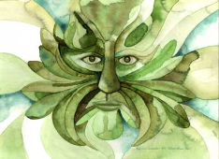
DNA STORIES
Each strand of DNA has an unbroken lineage to The Ancestor
DNA is older than most stones you might pick up
All creatures carry unmistakable marks of their own, and the more general history
A visiting alien biologist would only need a scoop of soil to reconstruct the essentials

Slide 30
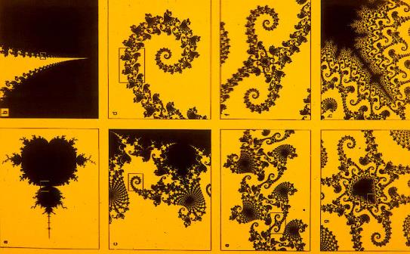

Slide 31
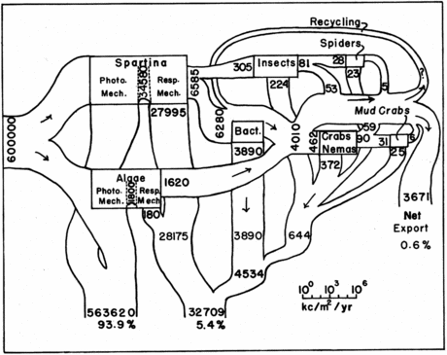
ENERGY FLOW IN A GEORGIA SALT MARSH What’s wrong with this classic diagram? J. M. Teal., Energy flow in the salt marsh ecosystem of Georgia. Ecology, 43:614-624, 1962.

Slide 32
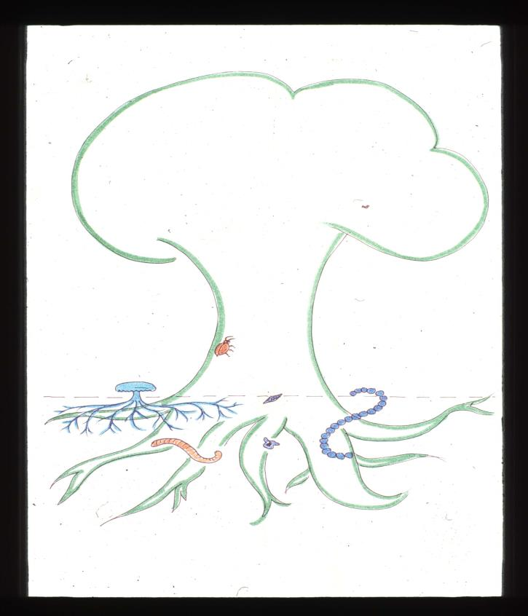

Slide 33
SOME RECENT DISCOVERIES IN ECOLOGY
Although large organisms have a small proportion of total biomass, they might have disproportionate effects
Smashups: Monbiot’s elephants
‘Landscapes of fear’
Whale faecal plumes
So ‘trophic cascades’ in the opposite direction
Overall probably largest contribution of vertebrates is to produce
Shit

Slide 34
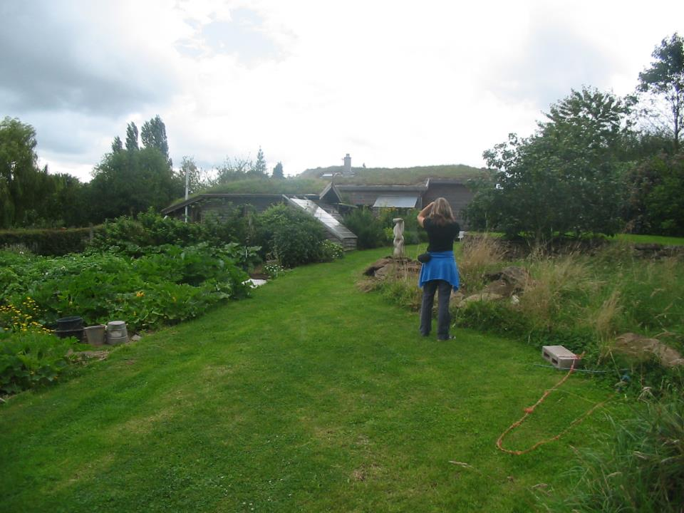
ONE GARDEN IN LEICESTERSHIRE.
2204 RECORDED SPECIES

Slide 35
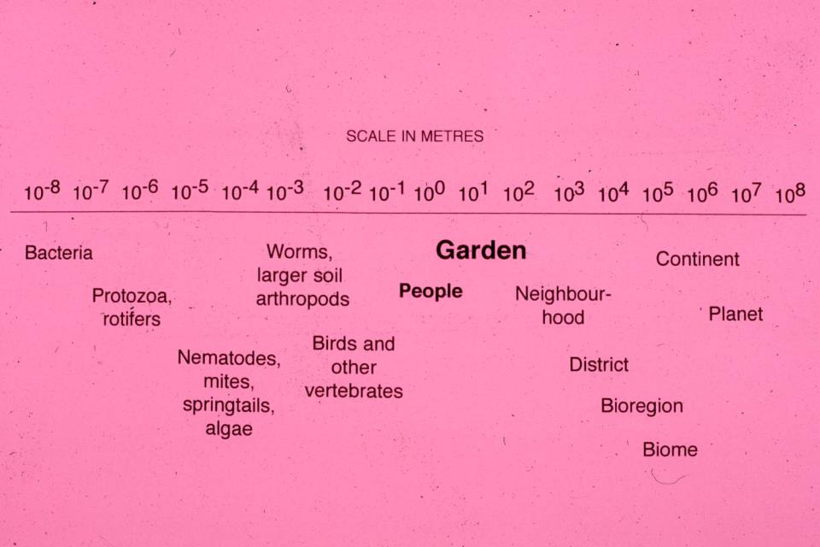
CAN WE EVER ESCAPE FROM THE MIDDLE?

Slide 36
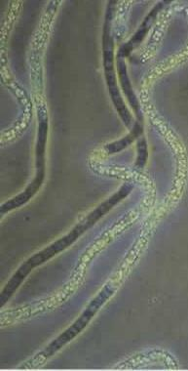
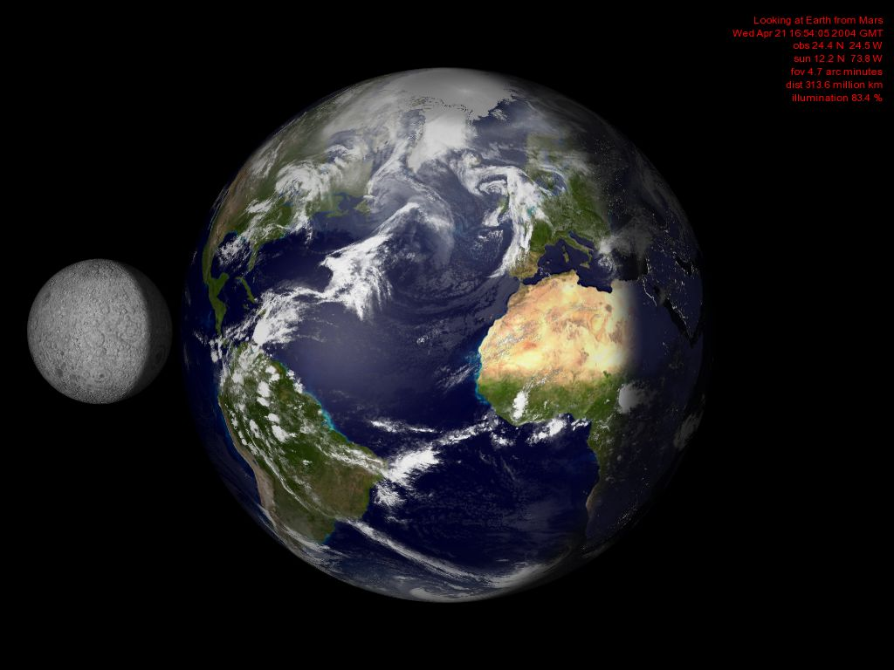
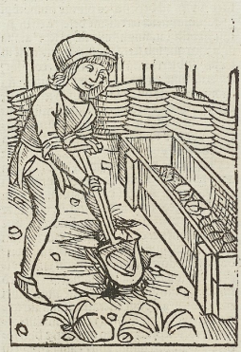

Slide 37
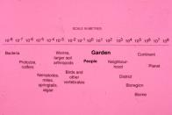
If the scale is expanded we are still somewhere in the logarithmic middle. Our world is Newtonian, between the quantum and the relativistic
The Solar System 10¹³
Atoms 10⁻¹¹
10⁻³⁵ The Planck Length
10²⁷ Size of the known universe

Slide 38
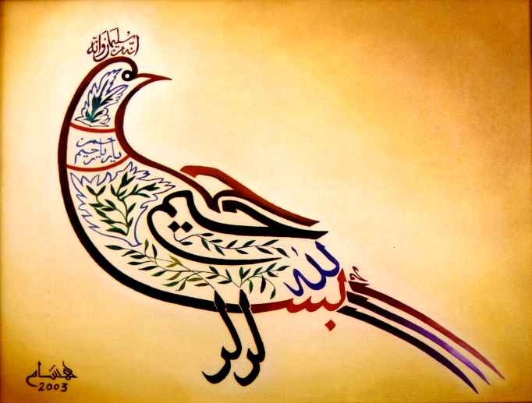

Slide 42
IS THIS REDUCTIONISM?
DNA essentially discovered by bacterial transformation, 1928
Identified by 1944
Structured in 1953
Is this the end of vitalism?
Vitalism comes naturally to us, but appears to be a poor guide to what is truly ‘natural’
Is monism less profound that dualism?

Slide 43
SOMETIMES A MONISTIC VIEW HAS A PLEASINGLY HOLISTIC EFFECT
When I was a psychology student, Lloyd Morgan’s canon specifically forbade anthropomorphic interpretations of animal behaviour
‘Evolutionary psychology’ not only allows it, but sanctions it as a source of insight
Because we are ‘all’ subject to the same evolutionary pressures

Slide 44
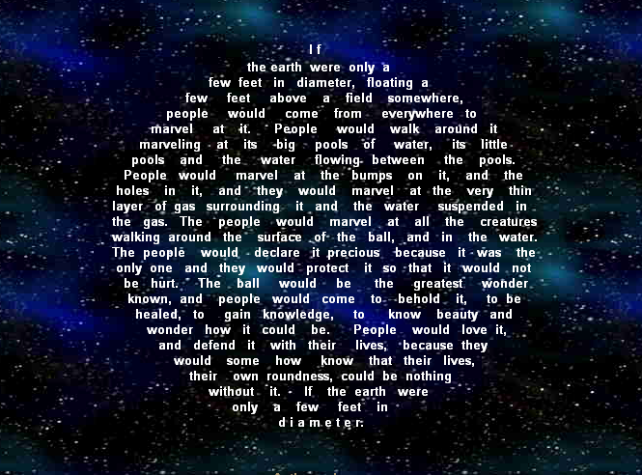
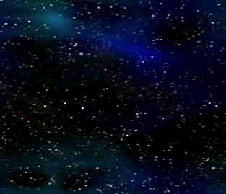
I f the earth were only a few feet in diameter, floating a few feet above a field somewhere, people would come from everywhere to marvel at it. People would walk around it marveling at its big pools of water, its little pools and the water flowing between the pools. People would marvel at the bumps on it, and the holes in it, and they would marvel at the very thin layer of gas surrounding it and the water suspended in the gas. The people would marvel at all the creatures walking around the surface of the ball, and in the water. The people would declare it precious because it was the only one and they would protect it so that it would not be hurt. The ball would be the greatest wonder known, and people would come to behold it, to be healed, to gain knowledge, to know beauty and wonder how it could be. People would love it, and defend it with their lives, because they would some how know that their lives, their own roundness, could be nothing without it. If the earth were only a few feet in d i a m e t e r.

Slide 45
GARDENERS FIND IT HARD TO RESIST ‘RANKING’ PLANT SPECIES Technically they’re all ‘weeds’: they not ‘cultivated’, or ‘well bred’
Monkshood | Dog violet | Dock
Pheasant’s eye | Heartsease | Thistle
Jacob’s ladder | Toadflax | Goosegrass
Snake’s head fritillary | Speedwells | Broadleaved willowherb
Bugle | Field scabious | Creeping buttercup
Columbine | Black knapweed | Bindweed
Lungwort | Common valerian | Plantains
Bloody cranesbill | Borage | Woundwort
Snowdrop | Forgetmenots | Chickweed
Purple loosestrife | Feverfew | Dandelions

Slide 46
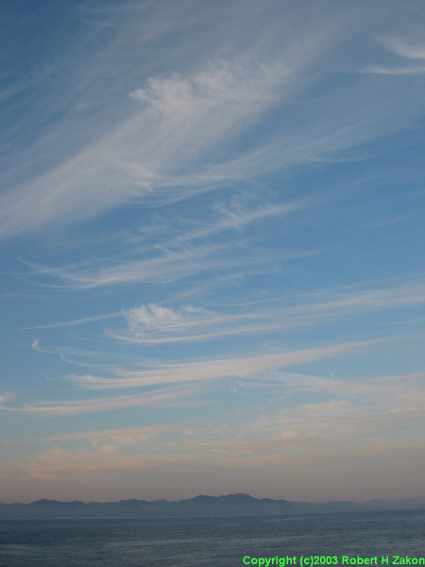
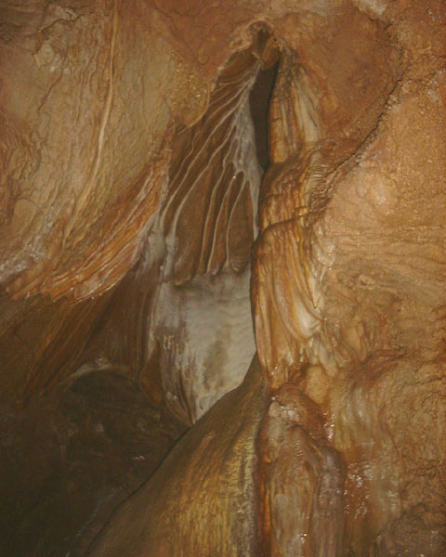
ABOVE GROUND SYMBOLISES | BELOW GROUND SYMBOLISES
Light | Dark
Extension, perspective | Enclosure, restriction
Air Fire | Earth, water
Vision, colour, | Touch, smell
Warmth | Coldness
Reason, sophistication | Instinct, the primitive
Dexter | Sinister
Transparency, clarity | Latency, ambiguity, the occult
Algorithms | Magic, symbols
Consciousness | The Unconscious
Growth, healing, cleanliness | Decay, corruption, rotting, filth
Creation, building up | Dissolution, breaking down
Big, attractive creatures | Small, repulsive creatures
Respectable livelihoods: grazing, hunting, gathering | Disreputable livelihoods: scavenging, coprophagy, body-snatching, parasitism
The Olympian gods, "beautiful people", ignoring the Dark Side of creation and heading for their Götterdämmerung | The dark gods, blind, lame, dwarfed, disfigured, planning the downfall of the Olympians

