Slide 1
LOW-CARBON LAND USE
Peter Harper

Slide 2
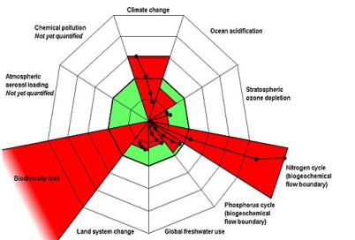
GLOBAL IMPACT OF HUMAN LAND USE
Human-appropriated net primary production (HANPP) about 25% of biosphere
Knock-on effects in nitrogen cycle and biodiversity, land-use, water, GHGs
Food the largest single land-consuming item
  Others, forestry, fibres, feedstocks, drugs, infrastructure
Partly driven by population growth
Changes of diet an equally strong driver
Not a physically sustainable trajectory

Slide 3
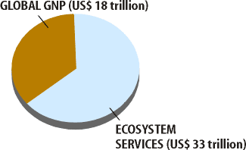
BIODIVERSITY AND ECOSYSTEM GOODS AND SERVICES
The UN-backed Millennium Ecosystem Assessment (MA) introduced a concept of ‘ecosystem services’ in 2005
www.maweb.org: an important source
We depend on these services; they have an economic value estimated at almost twice the world GDP
Adapted from
R. Costanza et al., “The Value of the World’s Ecosystem Services and Natural Capital,” Nature 387, 256 (1997).

Slide 4
PROVISIONING SERVICES
Substantial substitutions in some cases #
Food (agriculture, wild food)
Fibre (for clothing, paper) #
Fuel (biofuel) #
Biochemicals (e.g. feedstocks, pharmaceuticals) #
Genetic resources (e.g. new genes for crops) #
Water

Slide 5
REGULATING SERVICES
Can be subject to local minor substitutions
Air Quality
Climate regulation
Water flow regulation
Erosion control
Water purification
Natural hazard protection
Pest regulation
Disease regulation
Pollination

Slide 6
SUPPORTING SERVICES
Essential, cannot be substituted, but could stand small temporary overdrafts
Soil formation
Nutrient Cycling
Primary productivity
Water cycling
Oxygen production*
Provision of habitat

Slide 7
CULTURAL SERVICES
Could be temporarily suspended?
Socially constructed?
Spiritual & religious
Inspirational
Social relations
Aesthetic
Recreation & tourism
Scientific curiosity

Slide 8
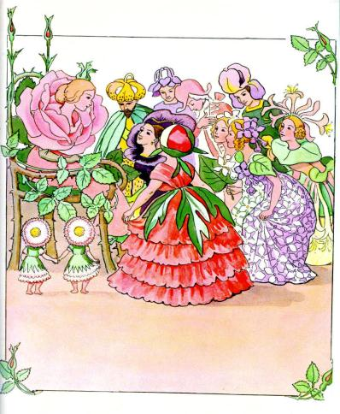
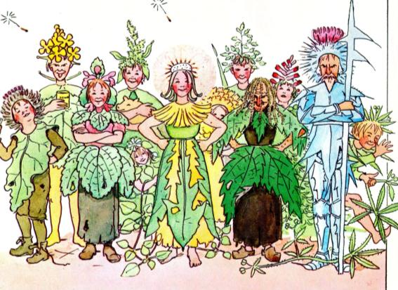
‘NATURE’ TENDS TO BE SEEN THROUGH A SOCIAL LENS
Elsa Beskov, Blomsterfesten i Täppan,
1914

Slide 9
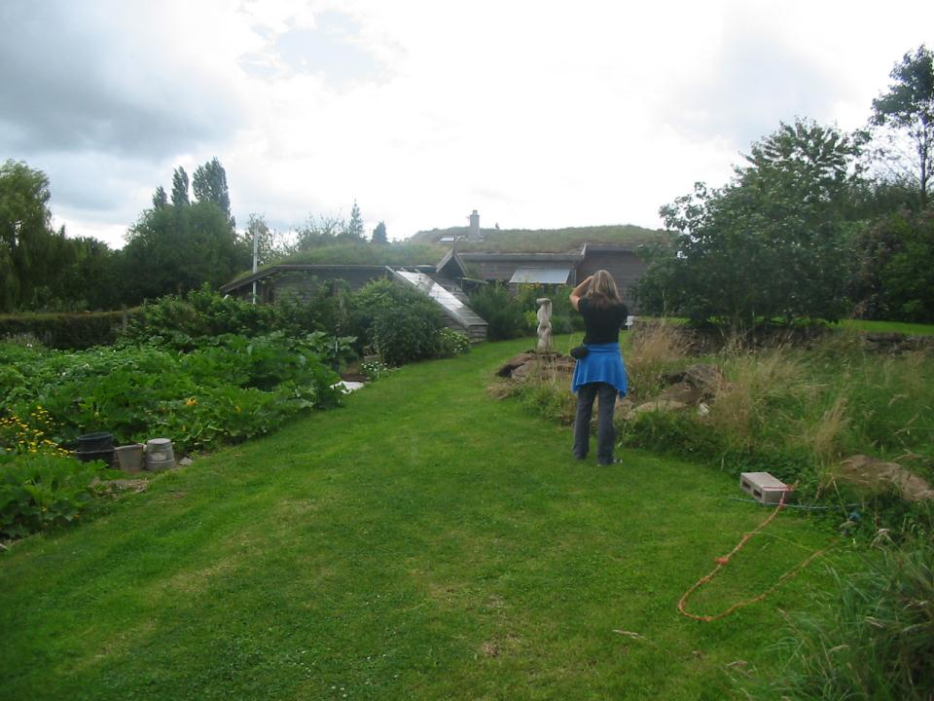
ONE GARDEN IN LEICESTERSHIRE.
2204 RECORDED SPECIES
Jennifer Owen, The Ecology of a Garden. Cambridge University Press, 1991

Slide 10
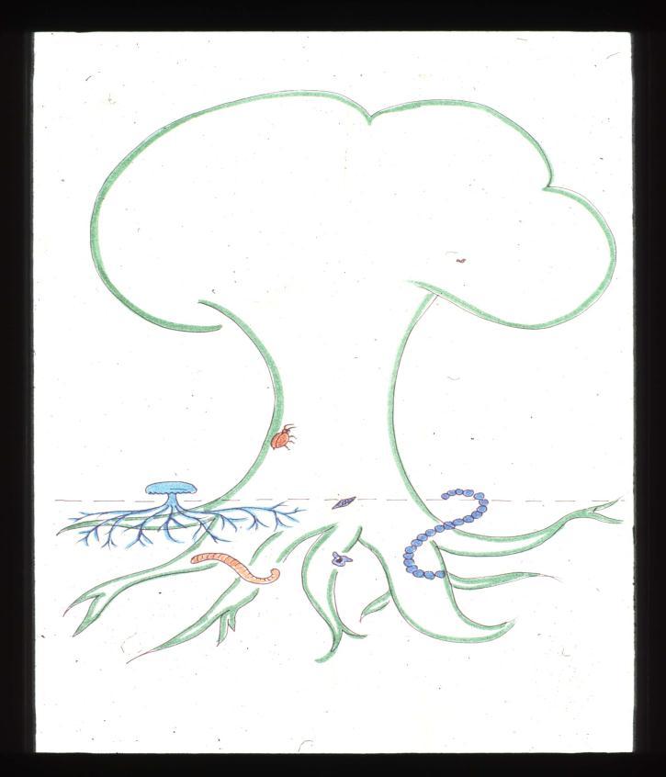

Slide 11
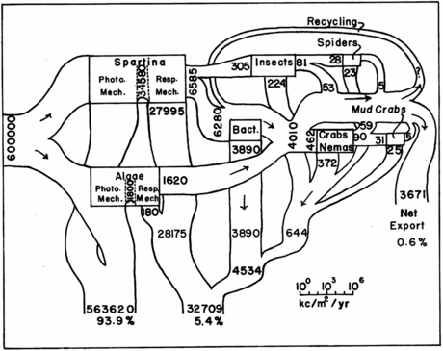
ENERGY FLOW IN A GEORGIA SALT MARSH
What’s wrong with this classic diagram?
J. M. Teal., Energy flow in the salt marsh ecosystem of Georgia.
Ecology, 43:614-624, 1962.

Slide 12

BASIC ECOLOGICAL PYRAMID
CARNIVORES
HERBIVORES
PLANTS

Slide 13
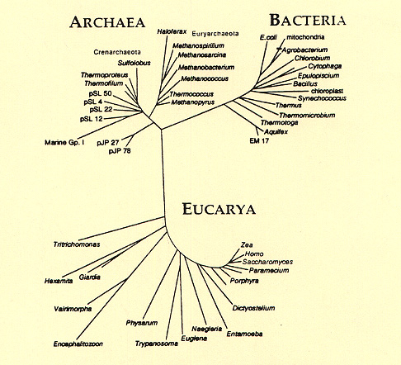

Slide 14
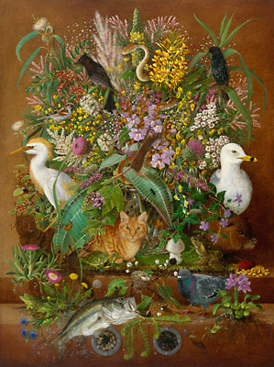
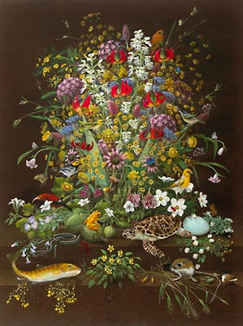
ASCENDANT AND DESCENDANT SPECIES
Isabella Kirkland

Slide 15
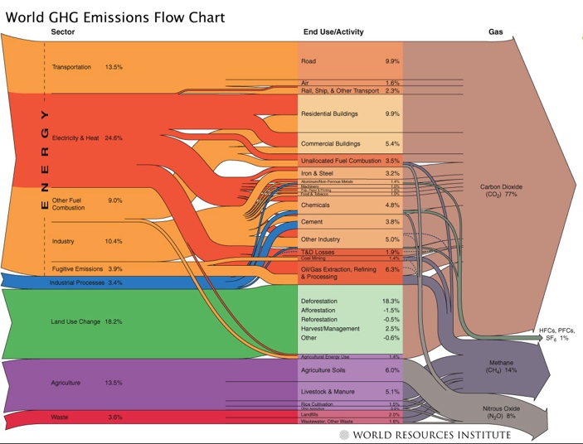

Slide 16
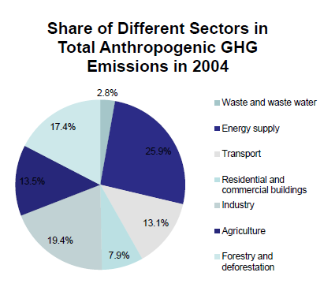
WORLD EMISSIONS
One third is not energy
Forestry and deforestation bigger than agriculture
But 58% deforestationcaused by agriculture (FAO)

Slide 17
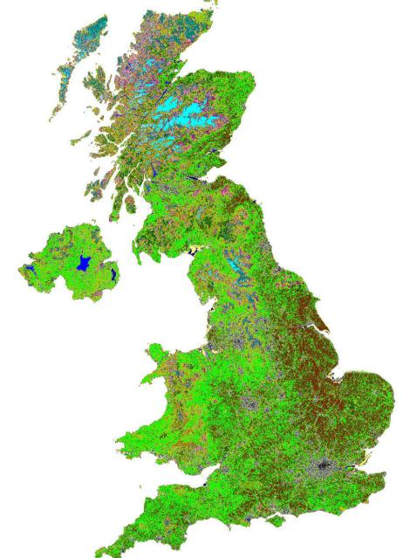
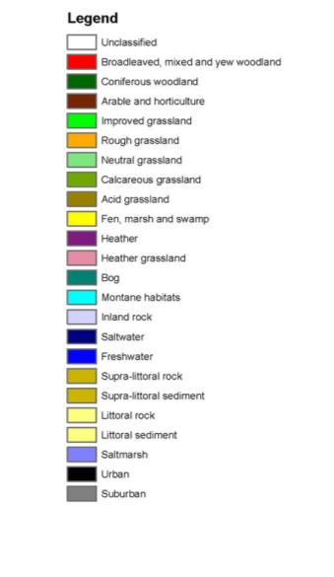
Centre for Ecology and Hydrology,
Land Cover Map, 2011.

Slide 18
WHAT DO WE MEAN,
“LOW CARBON”?
75% of UK land is agricultural, food the main product, so food and land-use inevitably interact
Land-use includes non-food, and food includes non-land: where are the boundaries best drawn?
Land use emissions dominated by N2O and methane, quite a different problem
Much harder to reduce technically

Slide 19
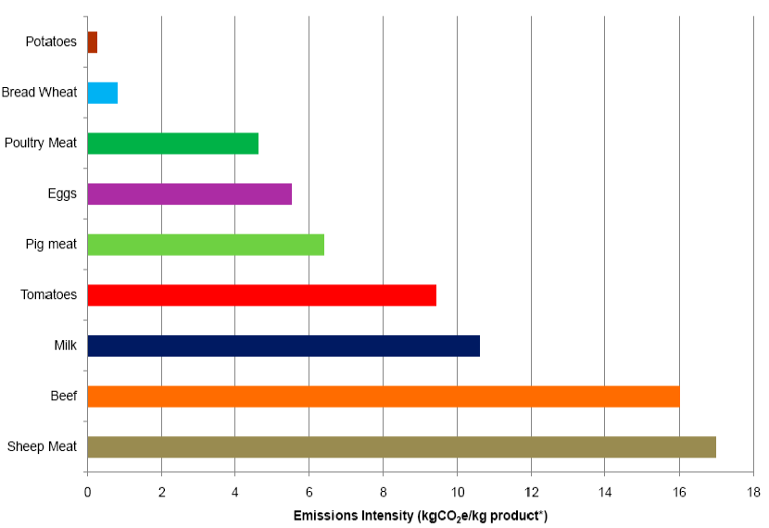
EMISSIONS INTENSITIES
Audsley et al.,

Slide 20
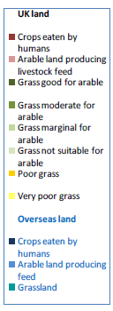


Slide 21
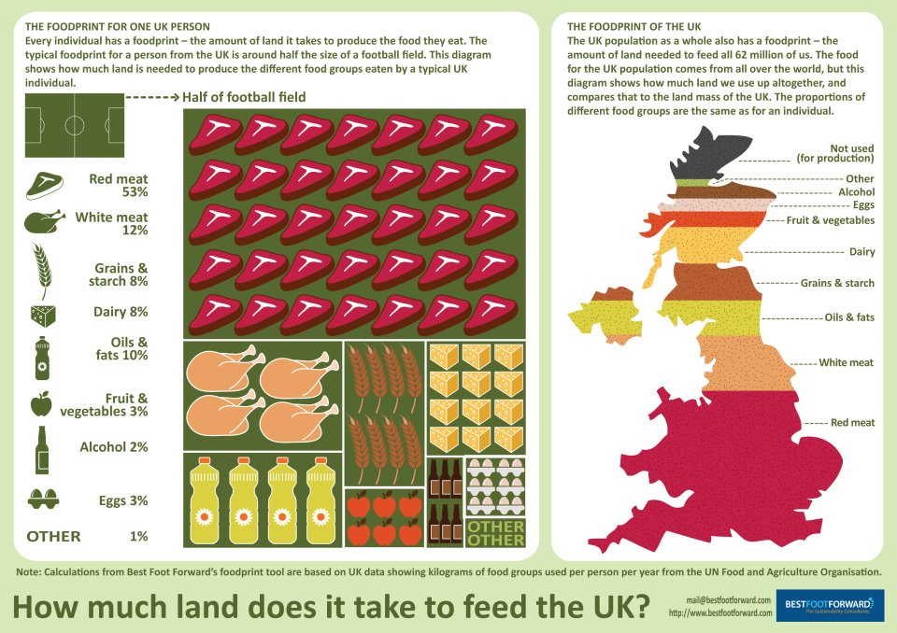
LAND REQUIREMENTS FOR UK FOOD
From Best Foot Forward

Slide 22
CARBON AND LAND ANALYSIS OF PRINCIPAL UK FARM PRODUCTS
From Zero Carbon Britain 2030
PROTEIN:
55% LIVESTOCK ORIGIN
45% DIRECT CROP ORIGIN
PLUS 40% IMPORTS WITH 60% EXTRA EMISSIONS, MOSTLY FOR FRUIT AND VEGETABLES

Slide 23
Re-ranking of land-use priorities?
Conservation of intact forest and other vulnerable GHG reservoirs
Production of low-emission foodstuffs
Renewable production of carbon-sequestering raw materials
Sequestration in biomass and soils
Production of low-carbon materials and energy
Habitat creation and conservation of biodiversity
Recreation and landscape values

Slide 24
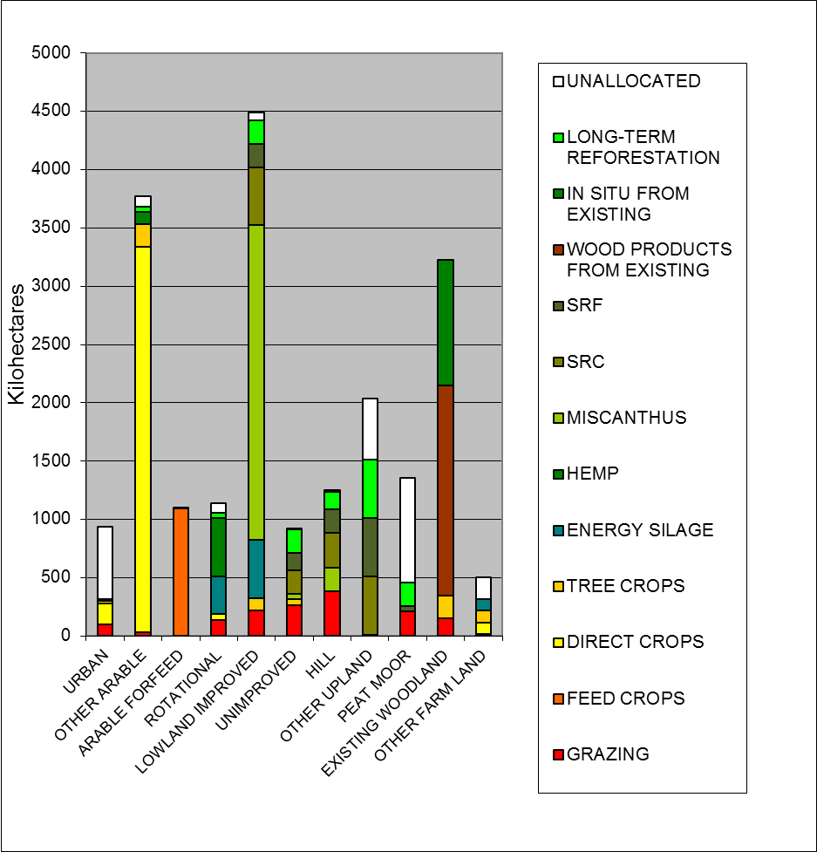

Slide 25
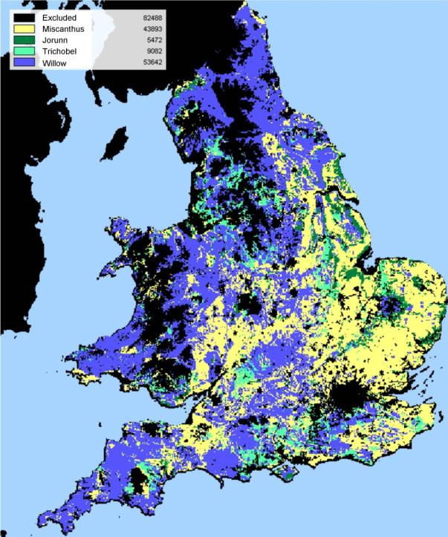
Taylor, G. (2006) http://www.tsecbiosys.ac.uk/downloads/Stakeholders_Workshop_Jul2009/28%20July/GTaylor_TSEC%20BIOSYS%20JUL09.ppt
Figure 5: Areas suitable for biomass crops mapped for England & Wales by Taylor (2006). Most of the land is potentially suitable, the main exclusions being urban areas and upland peat

Slide 26

THIS SCENARIO CLAIMS TO…
Decarbonise the UK economy
  Providing its own sources and sinks
Reduce N and P emissions to sustainable levels
Conserve regional biodiversity
Reduce pressure on other regions
Increase food security
Improve overall diets
Increase energy security

