Slide 1
ON-SITE RECLAMATION OF PLANT NUTRIENTS IN TOILET WASTES
Peter Harper

Slide 2
WHY RECLAIM PLANT NUTRIENTS?
If they are not reclaimed they are wasted
If they are not reclaimed, they cause pollution somewhere else
In the long run, some nutrients will be in short supply
Using household and toilet wastes to fertilise crops for home consumption probably guarantees a complete range of minerals for human health

Slide 3
WHERE ARE THE NUTRIENTS?
Toilet wastes
Greywater
Kitchen wastes
Garden wastes
Other
(vacuum cleaner, pet litter,
soiled papers etc)
Sewage stream
Solid waste stream

Slide 4
WHICH STREAMS ARE MOST WORTH RECLAIMING?

Slide 5
Urine, household organic wastes, and garden wastes rank high on all three criteria. Between them they account for 70-90% of the nutrient flow in most households.

Slide 6
Practical on-site nutrient reclamation systems should probably focus on these three streams.

Slide 7
USING URINE
Urine contains a wide range of nutrients, and is particularly rich in nitrogen
Nitrogen content depends on diet
High salt content causes problems for direct use
High ammonia content if stored
Best used immediately
Should always be diluted

Slide 8
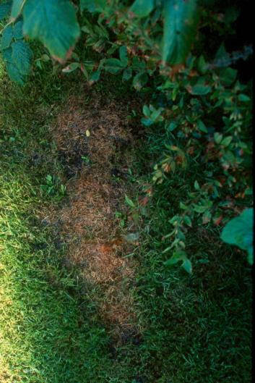
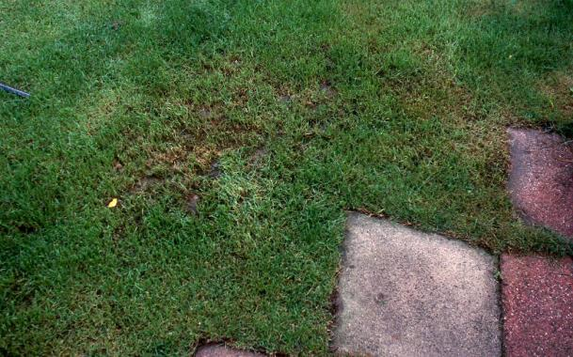
Urine damage to grass

Slide 9
COLLECTING AND STORING URINE
Well-designed collection devices are advisable
But they can be very simple
Different for men and women
Urine can be collected for immediate use, or
Stored for use later

Slide 10
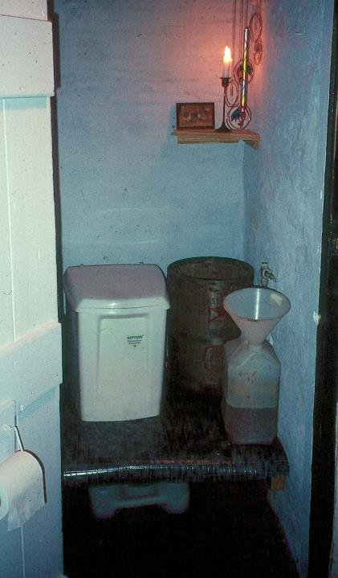
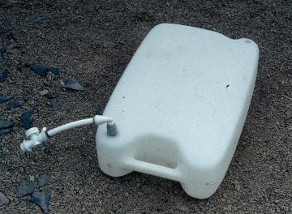
‘Ty Bach’ with collection systems for male and female

Slide 11
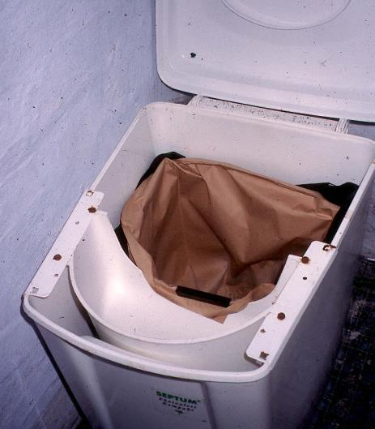
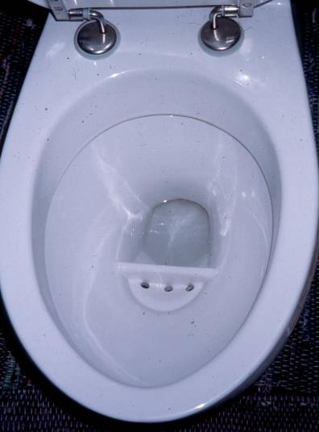
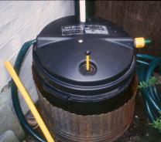
Notes:
On the left, a bucket toilet with urine bowl at the front. The urine runs to a flat tank under the false floor, illustrated.
On the right, a urine-separating flush toilet bowl, with urine running to a 30 litre tank outside.

Slide 12
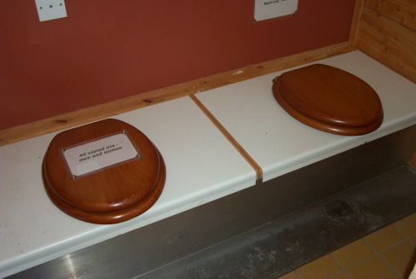
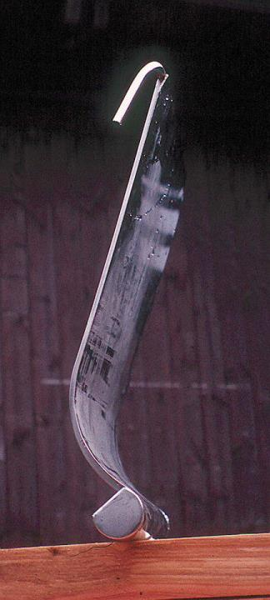
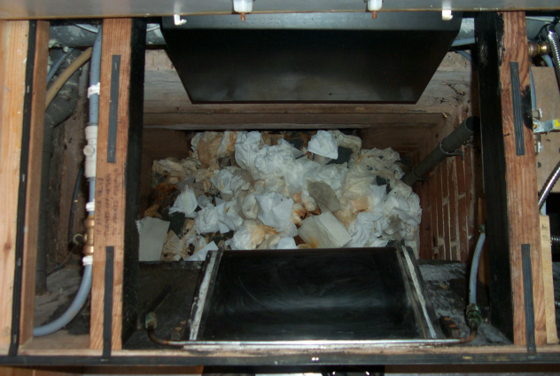
Notes:
Urine-separating twin-vault toilet produced by Messrs Natsol, Llanidloes, Wales.
Top, the lids on the twin vaults.
Lower left, a view into an operational vault with the top removed.
Right, the stainless-steel urine-separating plate. This depends on the Coanda effect to conduct liquid collected on the vertical face into the gutter at the bottom. The operational location of the plate can be seen in the lower left picture.

Slide 13
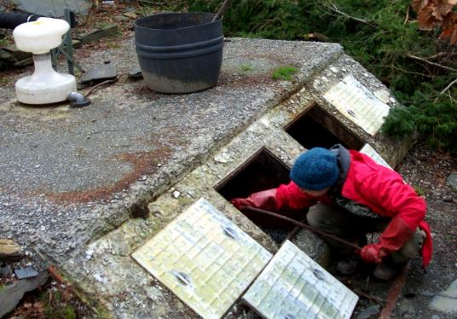
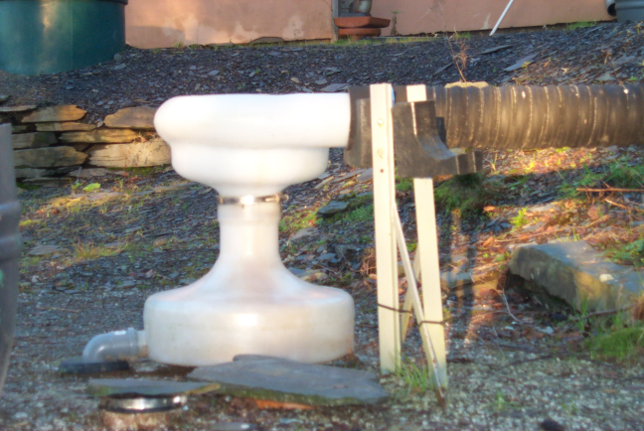
Notes:
A system for separating solids and liquids from flush toilets.
The combined flow from the toilets enters the shaped plastic chamber (bottom right), which uses the Coanda effect to entrain liquids, while solids fall through a central hole into the composting chambers, top left.
The solids are combined with high-carbon ‘soak’ material and produce excellent odour-free compost.

Slide 14
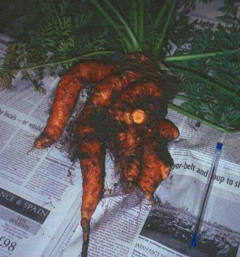
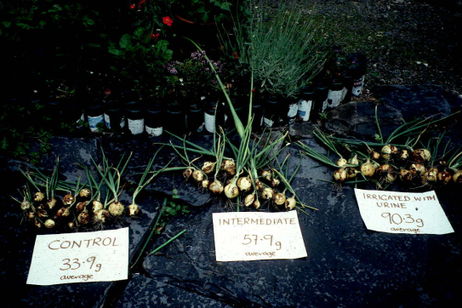
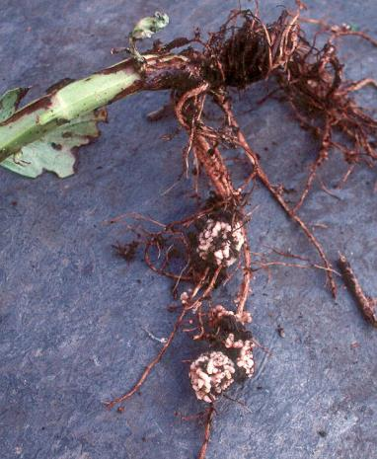
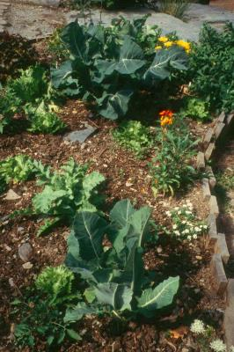
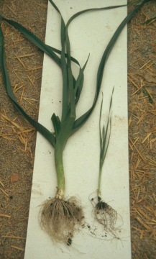
Some effects of regular applications of stored, dilute urine
Notes:
Diluted urine used in vegetable gardening. Top left, carrot growth is strongly enhanced, but becomes ‘forky’. Top right, overwinter onions showed a threefold increase in yield relative to control. Bottom left, green-leaved vegetables often develop a deep green hue as a result of urine fertilisation. Bottom centre, leeks grown in pure paper-mill de-inking sludge, left, with dilute urine, right, control. Bottom right, broad bean roots after urine fertilisation, showing that (contrary to organic lore) the nitrogen-fixing nodules are unaffected.

Slide 15
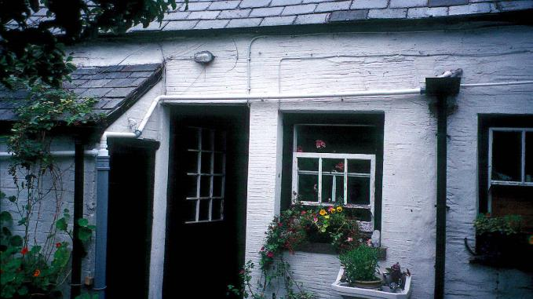
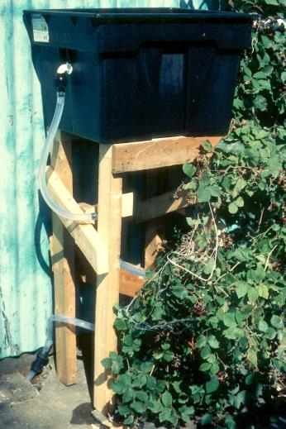
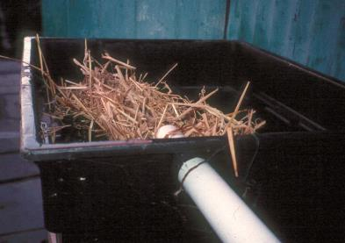
Notes:
A combined urine/grey water system at household level. Top right, a hopper that collects shower water and separated urine from the separating toilet shown in slide 11. The combined effluent runs to a straw filter in the tank at left, detail lower right. This tank provides a place where the two streams can mix before flowing passively into the garden. The logic of a straw filter is simply that, instead of being cleaned, it is simply removed and composted.
The rational for the system is that grey water contains little of interest to plants, while fresh urine is too strong. Together, they create a useful ‘fertigation’ fluid that was dubbed ‘House-Juice’.

Slide 16
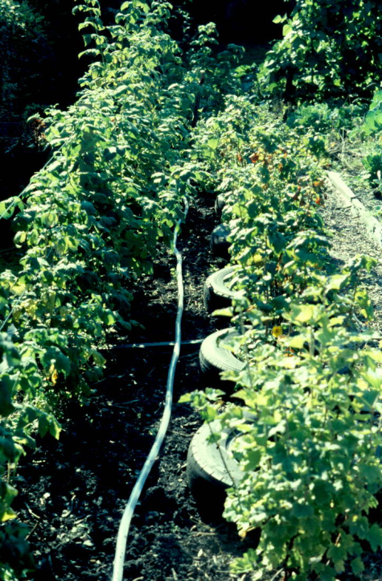
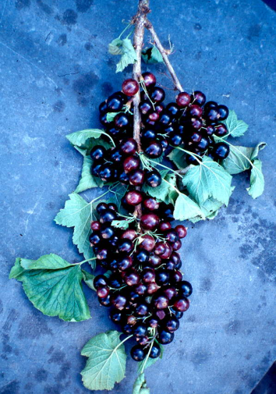
Notes:
Effects of ‘house-juice’ on soft fruit yields. Left shows ordinary hose with holes every 20 cm or so, normally covered by wood-chips and matting. Right shows effect on blackcurrant production.

Slide 17
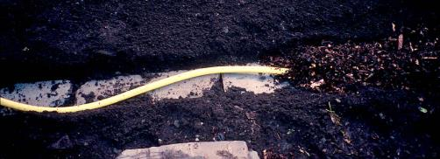
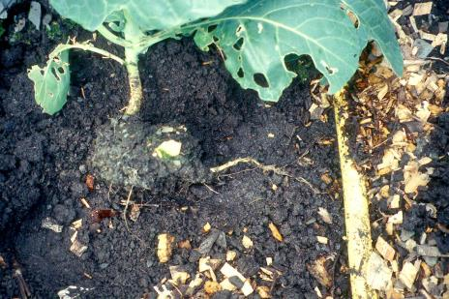
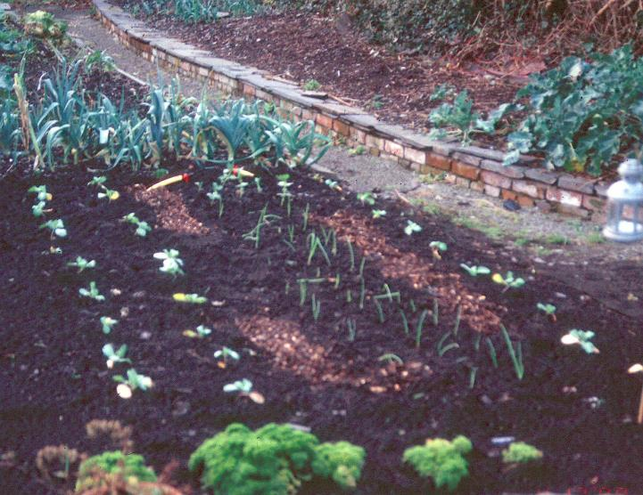
Notes:
House-juice used on annual garden crops, in trenches indicated by light brown lines of wood chip. Top left shows a perforated hose laid on a base of slate slabs before being covered in chip. Many plants do not benefit because their roots do not ‘forage’ and do not reach the enriched soil near the pipelines, but members of the genus Brassica certainly do, preferentially putting out strong roots towards the pipeline (right).

Slide 18
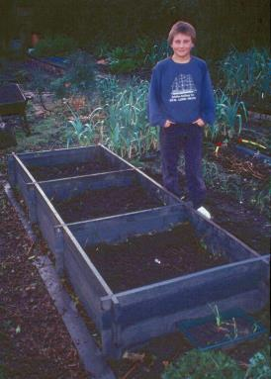
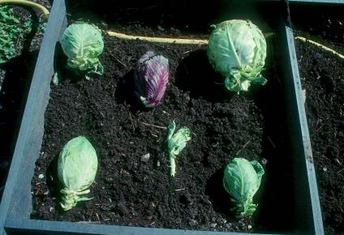
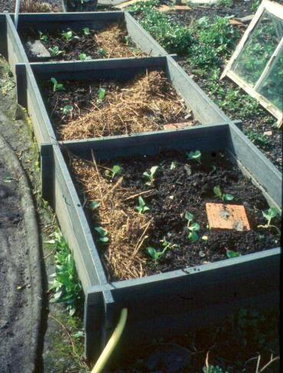
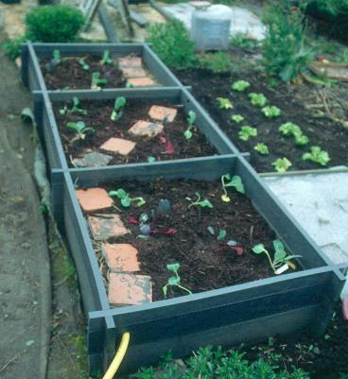
Notes:
Further trials of house juice, showing at least some effect on growth of winter cabbages, notably top right. Teenager for scale.

Slide 19
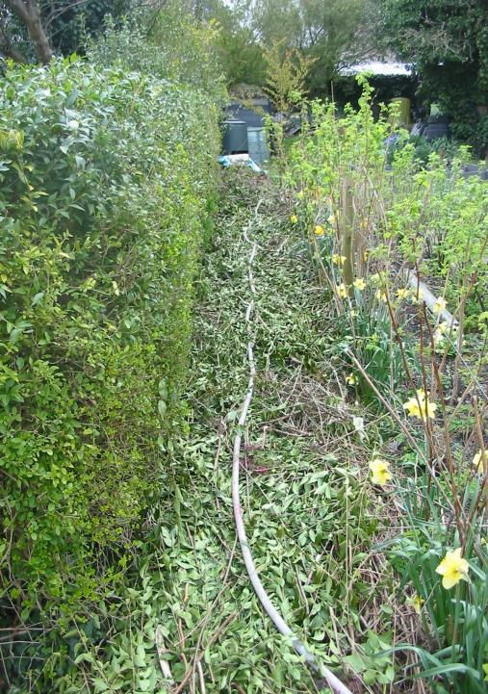
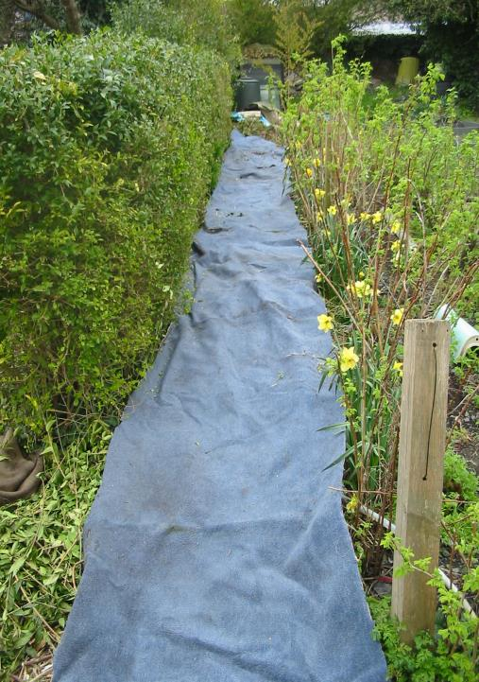
Notes:
Using house juice to accelerate breakdown of woody wastes – in this case, hedge trimmings. The logic is that woody wastes have too little nitrogen, and this is supplied by the house juice. In practice, accelerated decomposition is observed in an area of radius 20 cm or so round the perforations, so it works a bit, but probably justifies two lines and more perforations.

Slide 20
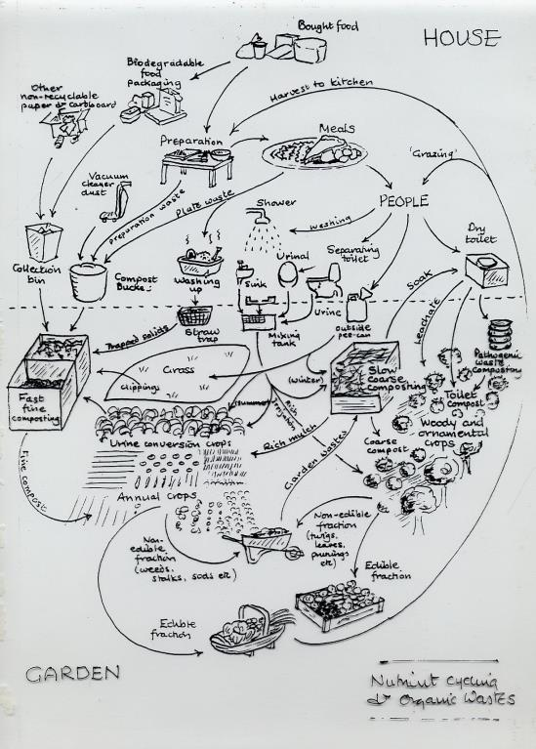
House
Existing system for on-site nutrient recovery
Garden
Notes:
Diagram summarising the recommended nutrient flow in a garden trying to make maximum use of all its wastes. Worth studying in some detail. Note there is no attempt to reclaim faeces from the main toilet, so a sewer connection remains essential.

