Slide 1
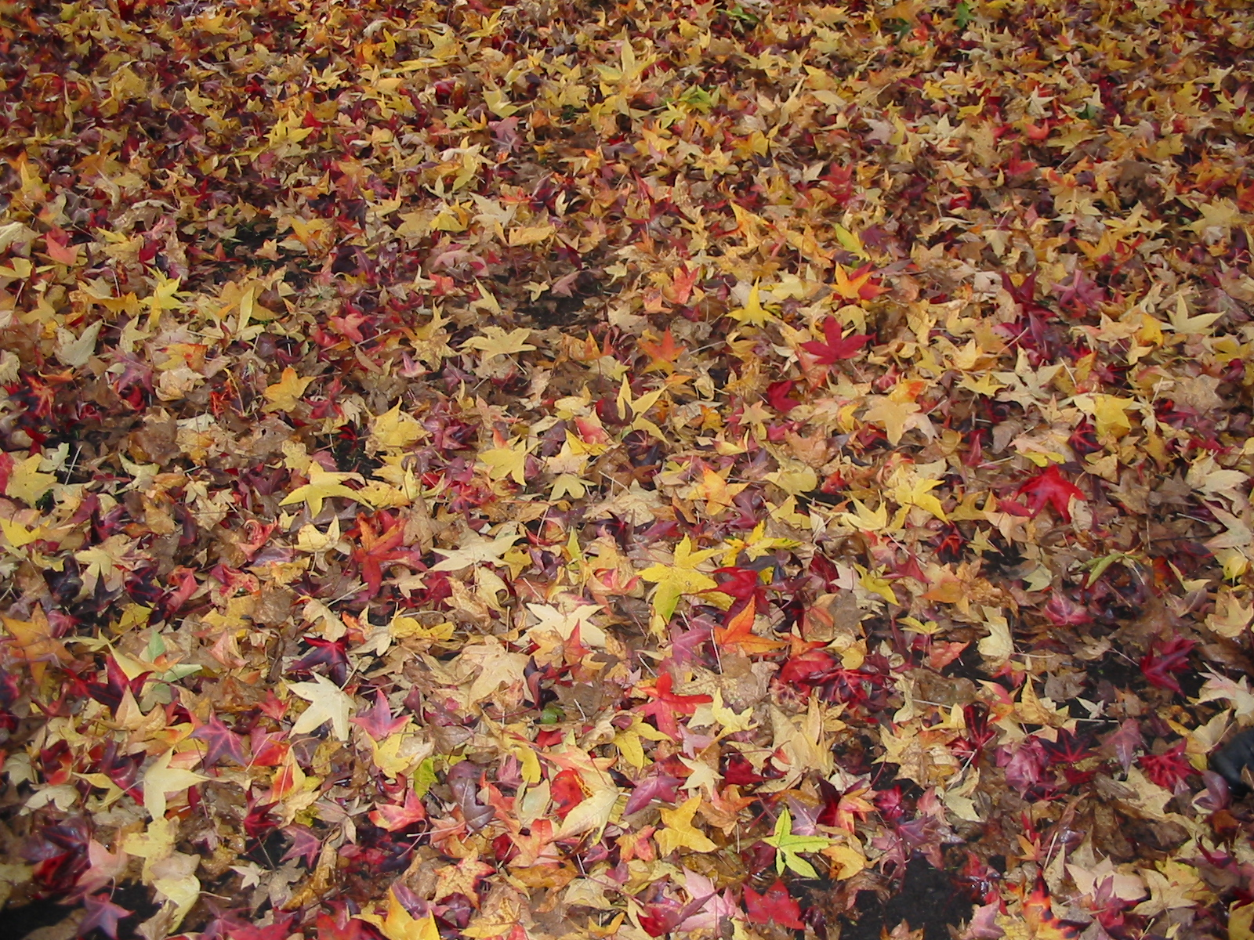
40 years later….
Peter Harper
Centre for Alternative Technology
Wales

Slide 2
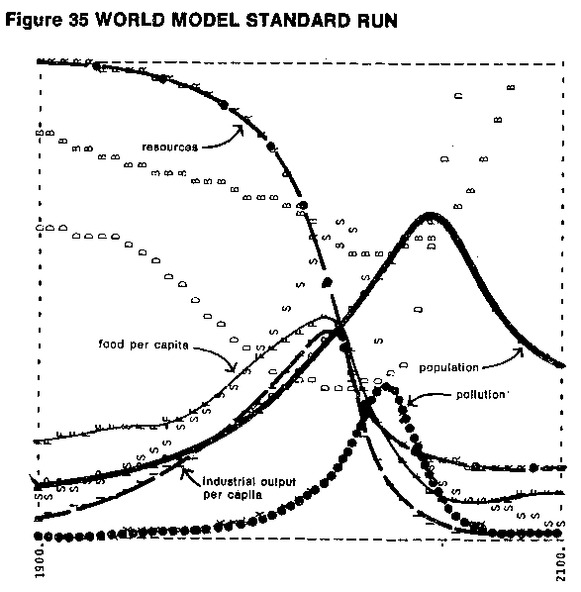

Slide 3
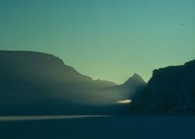
THERE ARE LIMITS AND THEY HAVE AN INFLUENCE
Limits to Growth study of 1970/71
A major influence on environmental analysis and policy by 1972
At its core, two uncertain assumptions
That ‘resources’ cannot be substituted
That various kinds of ‘pollution’ are additive and global
“We” took a precautionary view, while the mainstream took a ‘hope for the best’ view
Hence our ‘neo-primitive’ approach to resources and pollution, ‘Alternative Technology’ etc

Slide 4
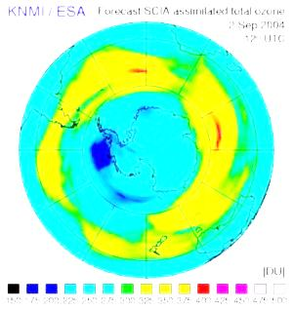
BUT
By the 1990s it looked as if the mainstream was right
Resources’ were apparently easily substituted
Especially minerals
‘Environmental impacts were not additive, and in principle could be addressed one at a time
Stratospheric ozone was a particularly persuasive case
Also acid rain, urban air quality, river and lake pollution, factory emissions, persistent toxic chemicals etc

Slide 5
MAINSTREAM MODEL
Black bars, costs and impacts
PHYSICAL SCALE OF ECONOMY GROWS
Open bars, the economy
‘EXTERNAL COSTS’ INCLUDING ENVIRONMENTAL IMPACTS HELD AT AN ACCEPTABLE LEVEL

Slide 6
ALTERNATIVE MODEL Looking a bit harsh by the 1990s?
PHYSICAL SCALE OF ECONOMY MAINTAINED AT AN ACCEPTABLE LEVEL
‘EXTERNAL COSTS’ INCLUDING ENVIRONMENTAL IMPACTS GRADUALLY REDUCED

Slide 7
HOWEVER…
By the beginning of the 21st century it was becoming clear that one class of ‘pollution’ (greenhouse gases) is additive and behaves very similarly to the original LtoG pollution parameter
Further, if ‘resources’ are interpreted to include sinks, then they are clearly running down and are difficult to substitute
As a parallel observation, the LtoG ‘resources’ curve approximately matches the decline of cheap oil and gas

Slide 8
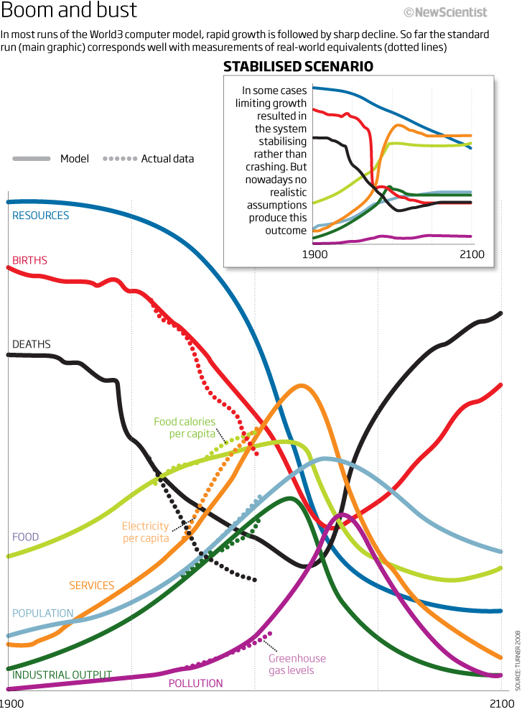
Limits to Growth (1972) ‘Standard run’ with additions by Turner (2008) BACK ON TRACK!

Slide 9
ROCKSTRÖM et al., Nine ‘PLANETARY BOUNDARIES’

Slide 10
THIS IS WHY THE 2010s FEEL LIKE THE 1970s
‘FIRST WAVE’ of environmentalism
‘SECOND WAVE’
CLIMATE CHANGE ERA
ERA OF EVIDENCE-BASED REASSESSMENT
LINEAR MODELS
UNCHE
RISK-OF-FEEDBACK MODELS
ERA OF ‘PRECAUTIONARY PESSIMISM’
MORE ‘PRECAUTIONARY PESSIMISM’

Slide 11
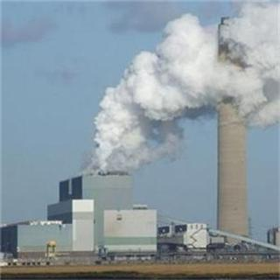
ROCKSTRÖM et al., Nine ‘PLANETARY BOUNDARIES’

Slide 12
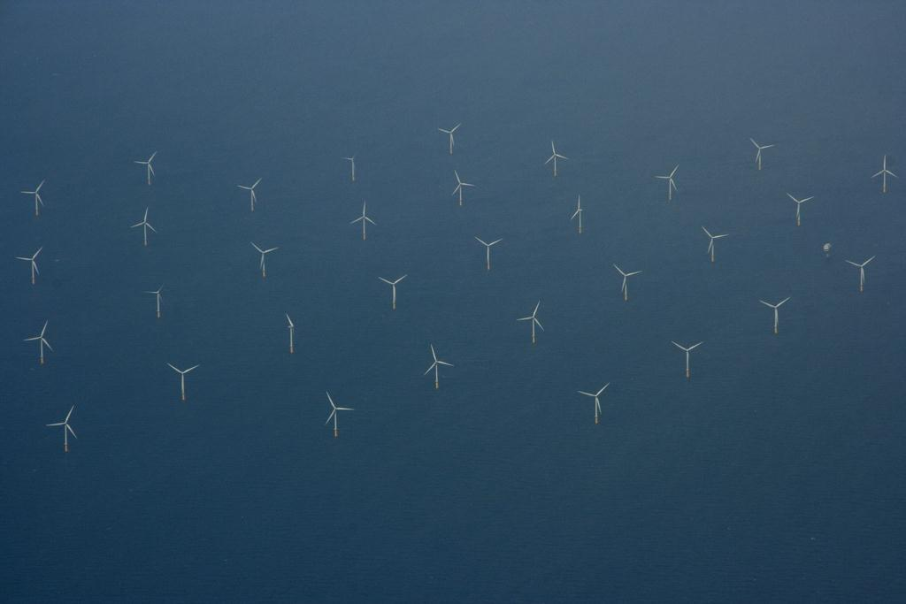
THE NEW ENVIRONMENTAL TECHNOLOGY
Now we try hard not to require behavioural changes!
but we fail in some areas
Great emphasis on control of demand, but not in terms of ‘lifestyles’
Supply mostly very big, along with major infrastructure changes
It can be done with 100% renewable technology, but all technologies must be ‘on the table’
It probably cannot be done without major changes in diet and land use

Slide 13
IN A NUTSHELL
‘MAD MAX’ →
Insistence on maintaining the status quo eventually destroys it
Applying necessary adjustments and living with some limitations maintains as much as possible of the status quo
COSTS, RISKS, EFFORT, AND GENERAL UNPLEASANTNESS
‘SWEDEN’ →
TIME, 21ST CENTURY

Slide 14
ALTERNATIVE MODEL JUST LIKE PEOPLE
PHYSICAL SCALE OF ECONOMY MAINTAINED AT AN ACCEPTABLE LEVEL WITH GRADUAL IMPROVEMENT IN QUALITY
‘EXTERNAL COSTS’ INCLUDING ENVIRONMENTAL IMPACTS GRADUALLY REDUCED

Slide 15
IT CAN BE DONE
Not impossibly difficult, technically
Not an unattractive prospect
MUCH better outcome than not doing anything (or not doing enough)
After 40 years of inertia, ‘Mad Max’ looks more likely than ‘Sweden’
But we are still here, and we shall keep batting for ‘Sweden’

Slide 16
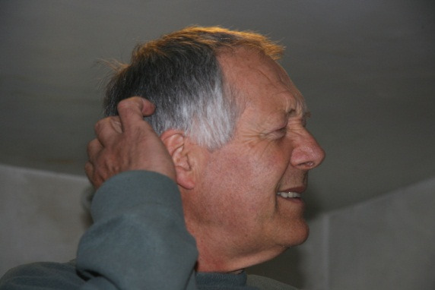
SWEDEN
MAD MAX
THE END?

